Slide 1
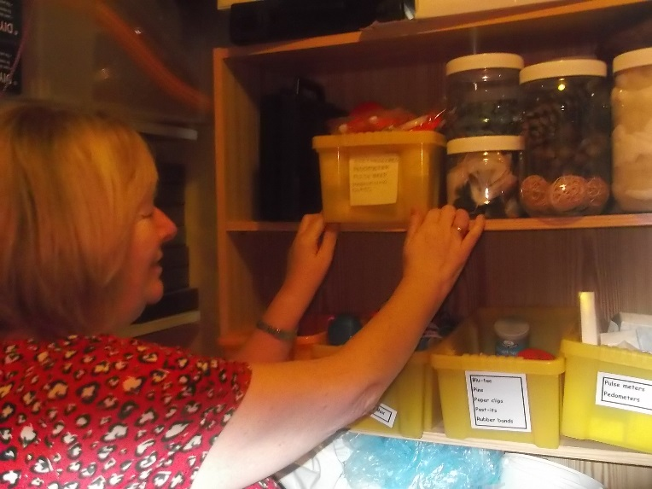
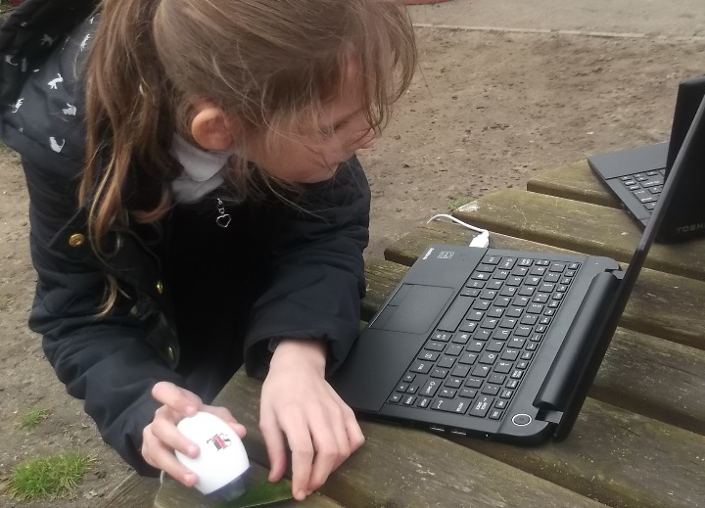
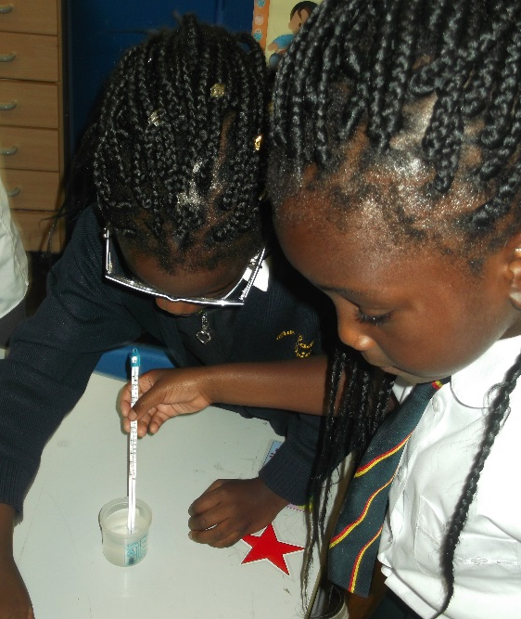
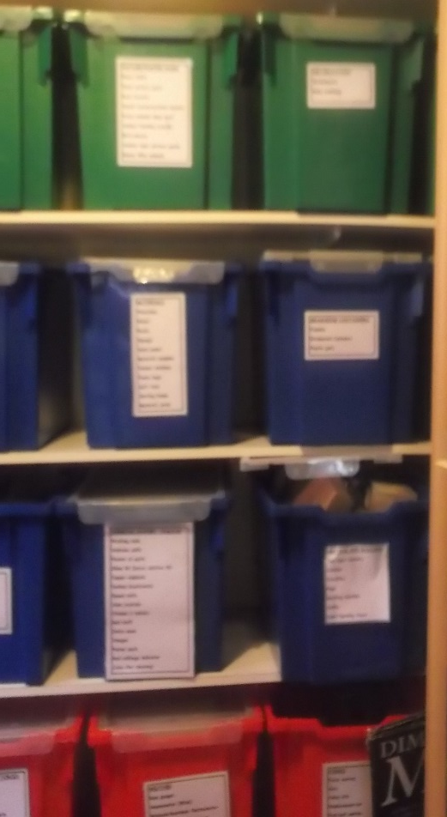
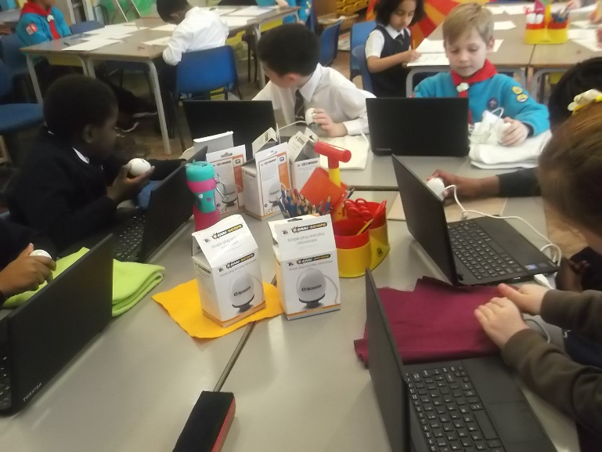
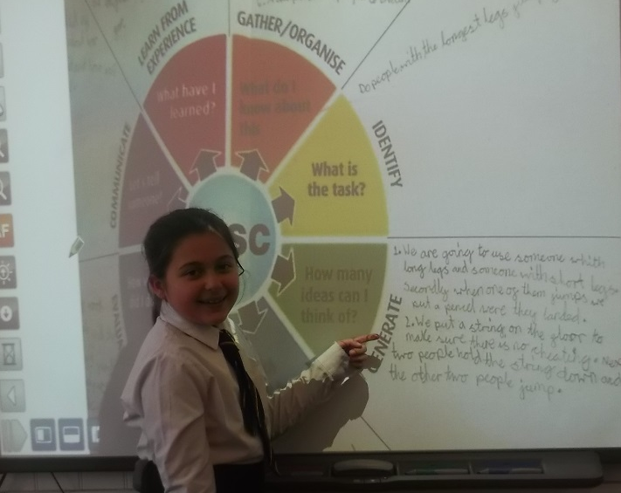
There is a range of up-to-date, quality resources specifically for teaching and learning Science. ICT is used both as a tool and as a resource for teaching
Did you notice the temperature has risen?
The detail on this leaf is amazing!
Year 3
Year 1
I can always find what we need for science lessons.
Teaching assistant
Technology used in and outside of the classroom.
I love sharing my work on the IWB with the visualiser
Year 3
A wide range of well organised resources.
Digital microscopes, data loggers, rechargeable torches and stop watches support learning.

Slide 2
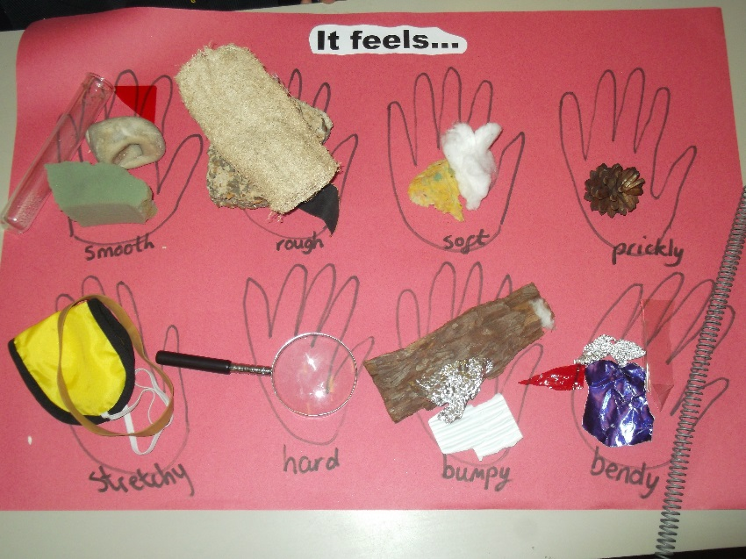
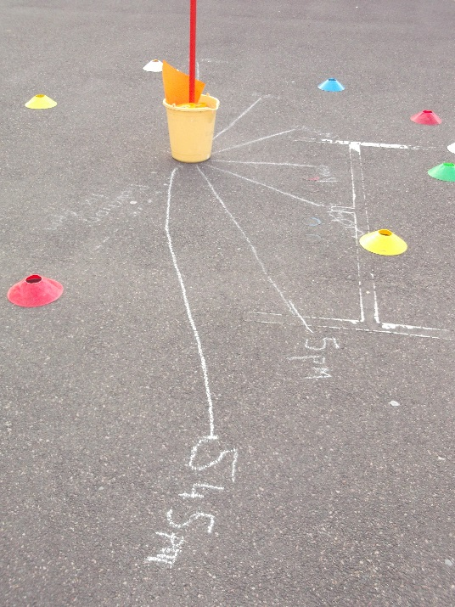
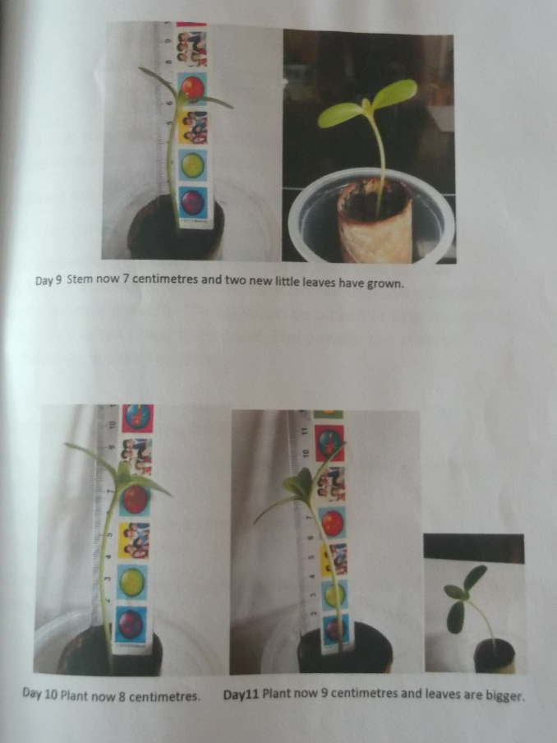
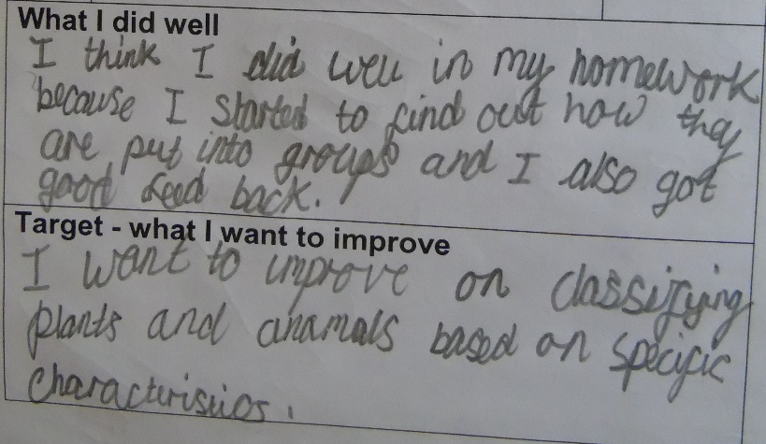
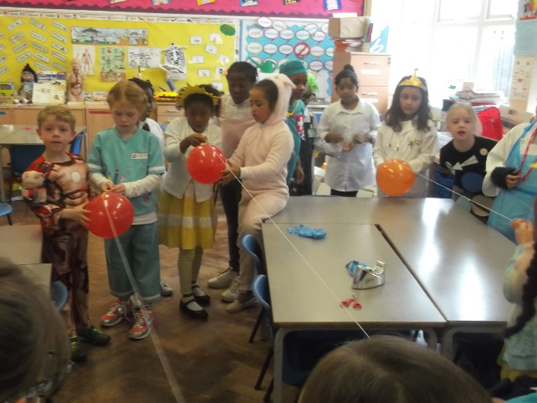
All pupils are actively engaged in a science enquiry; using a variety of enquiry strategies, independently making decisions, using evidence to answering their own questions, solving real problems, evaluating their work.
Year 2
Observation over time: how seeds grow into plants.
Year 3
Identifying and classifying: Creating an exhibition for the curator of the science museum
Year 1
Observation over time: How does my shadow change during the day?
Fair test: during science week – what affects how well my balloon rocket travels?
Opportunities to evaluate their own work.
Year 3 and 4
Year 6

Slide 3
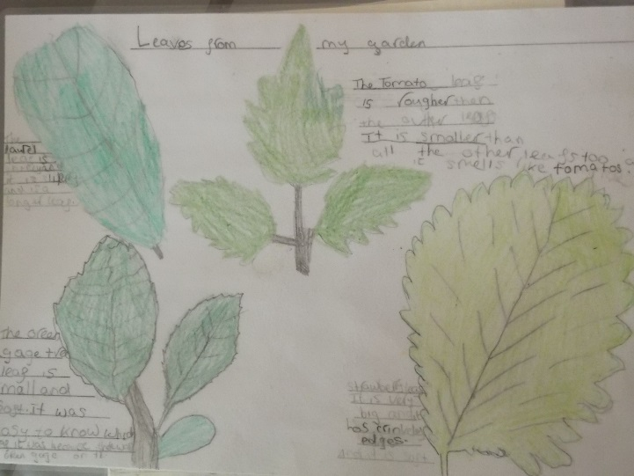
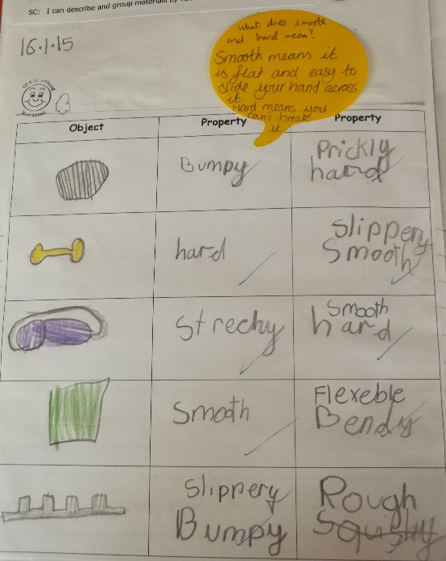
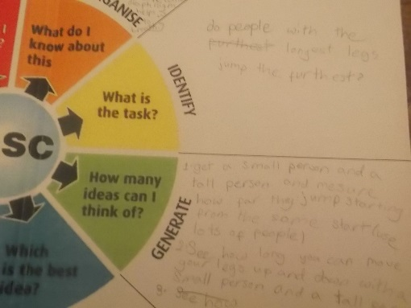
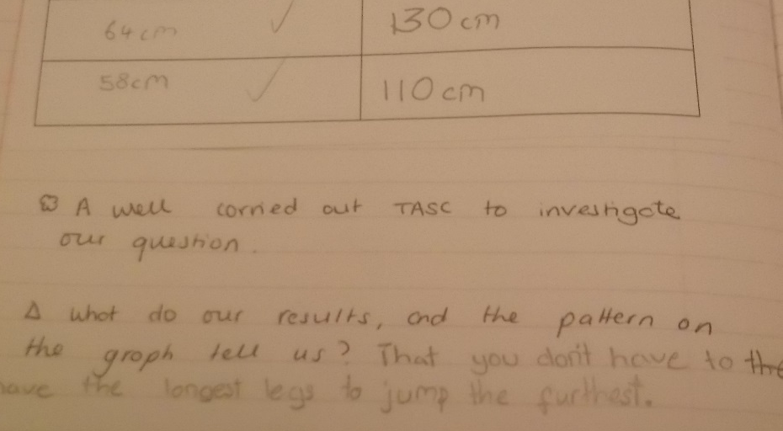
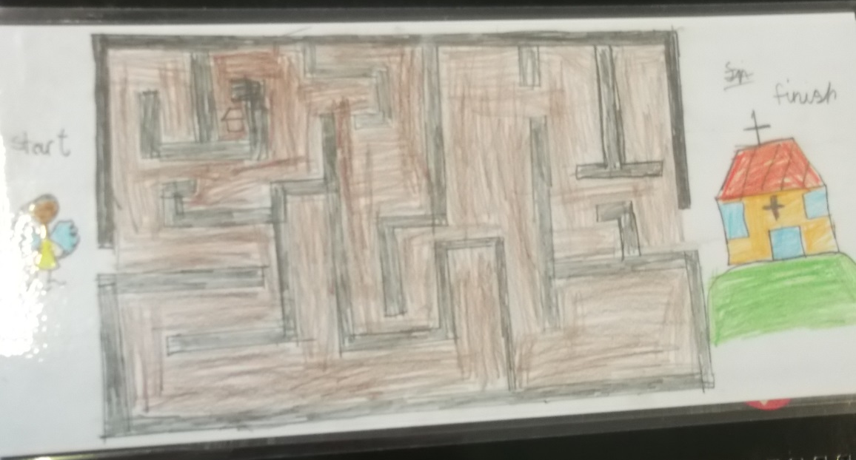
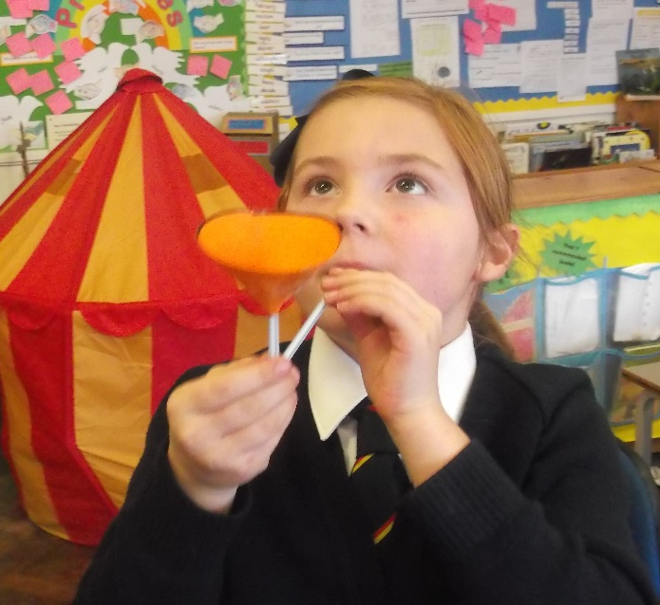
Year 1
Pattern seeking through TASC: can taller people jump further?
Year 2
Identifying: Homework activity – what plants can I identify that grow in my garden?
Exploring: the different properties of materials.
Year 3
Exploring ideas: Science club – forces in action. Can I move the ball without touching it?
Research: Can I make a game that uses a magnet?
Years 2-5

Slide 4
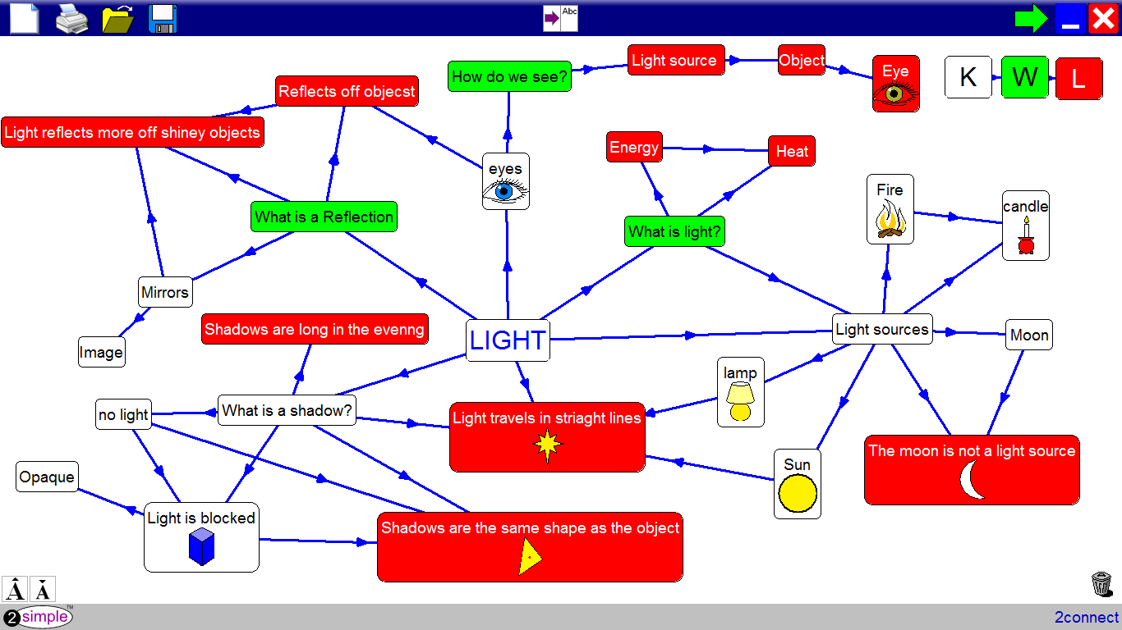
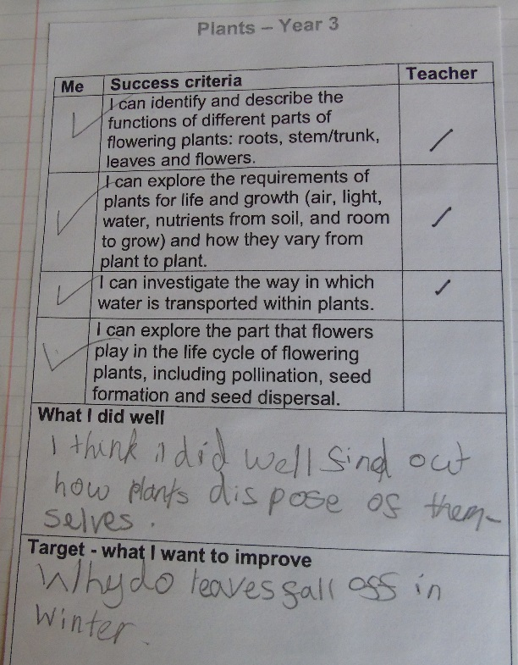
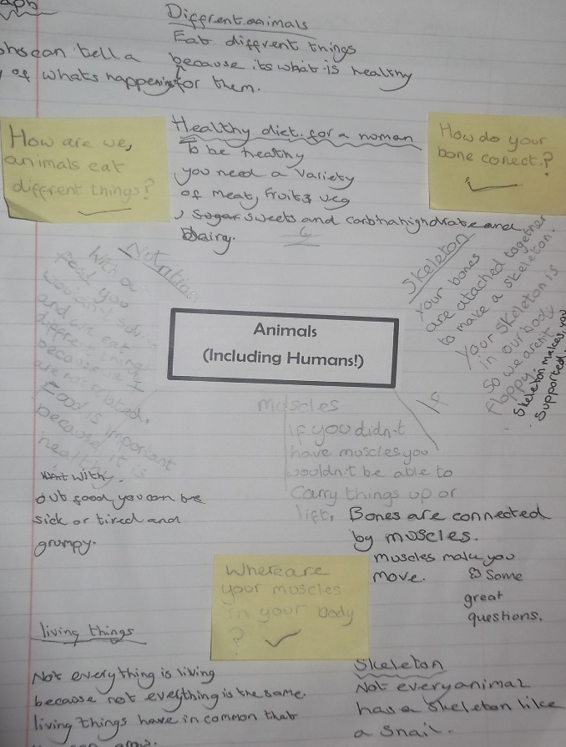
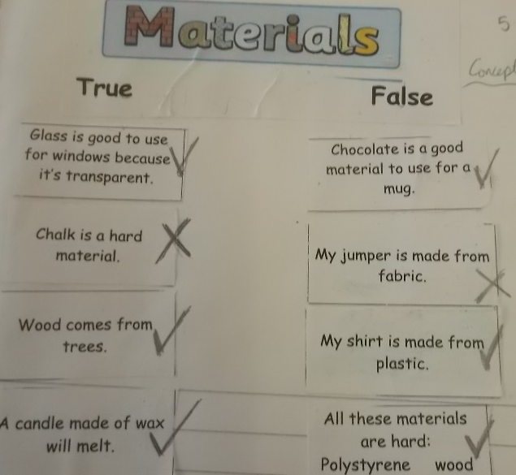
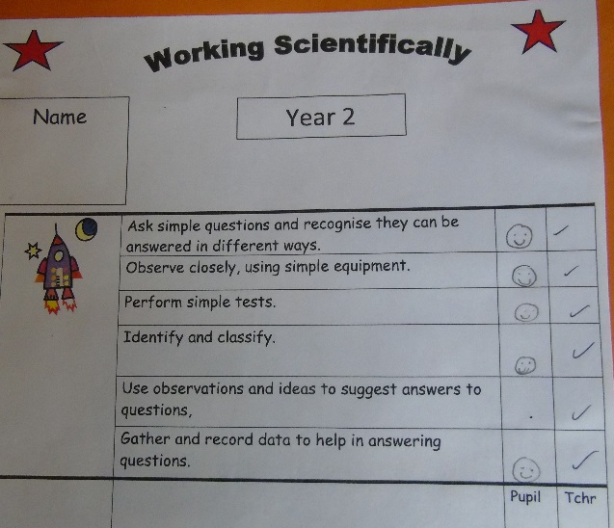
The purpose of science assessment is well understood and shared by the members of the school community. Assessment approaches are designed to fit those purposes.
Year 3
Teachers and pupils use concept maps to show initial knowledge, new understanding and inform planning. Updates form part of teacher and self assessment.
Year 6
Each topic is teacher and self assessed to national curriculum statements during the topic. This enables intervention to be put in place if pupils are not meeting their targets.
Year 2
Teachers use a variety of other assessment tools such as true/false statements
Working scientifically targets are assessed throughout the year

Slide 5
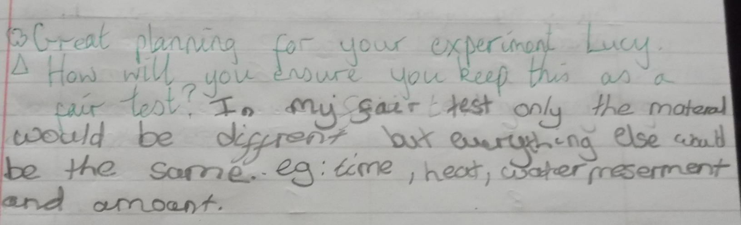
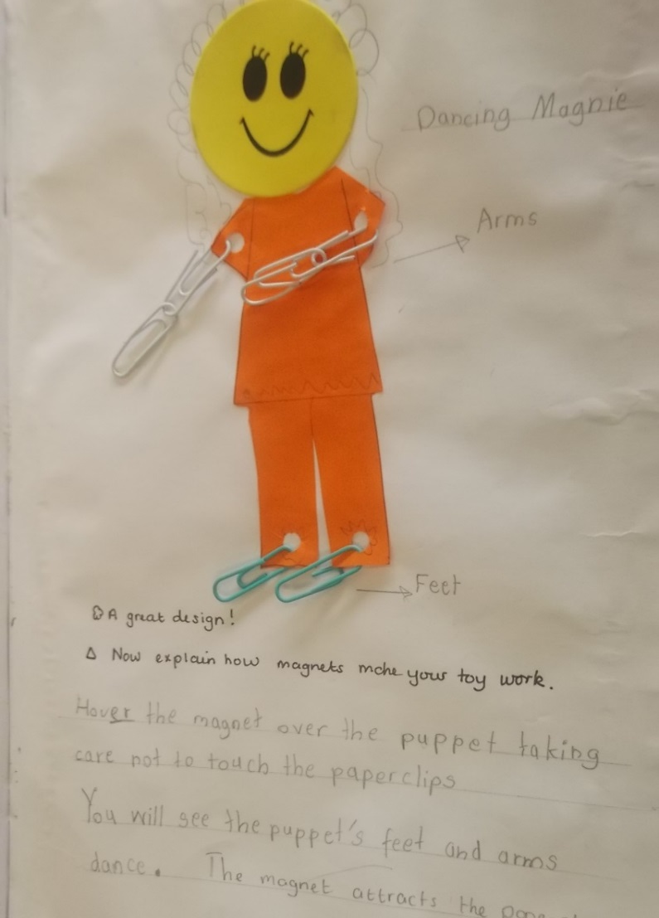
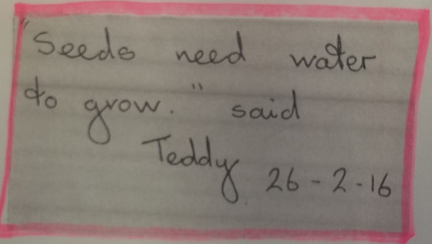
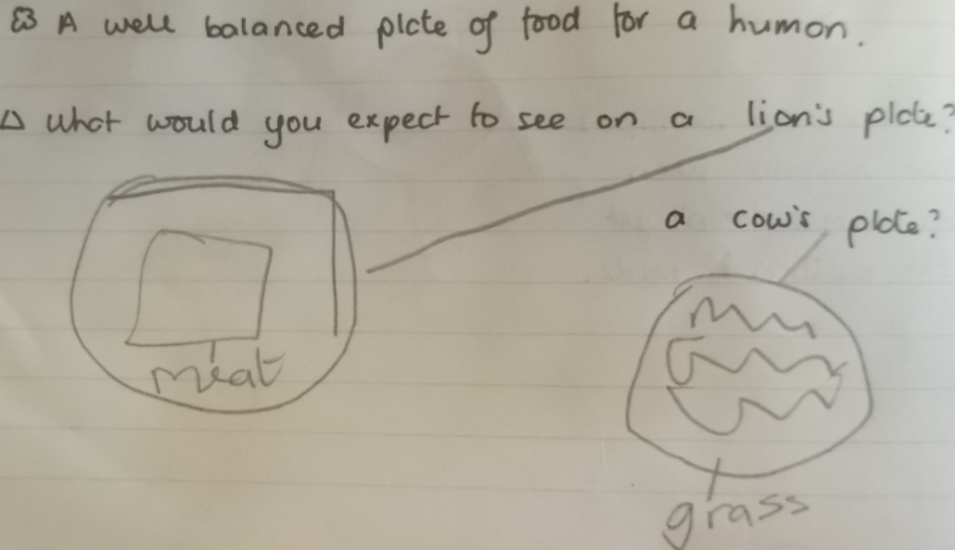
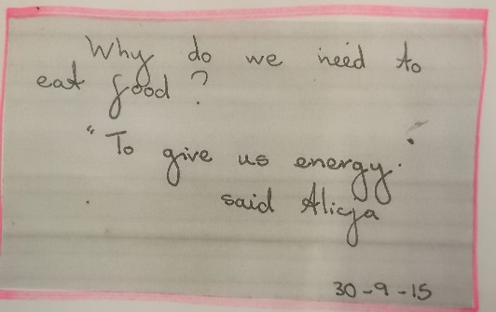
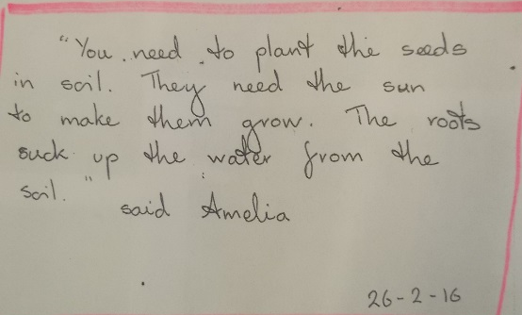
Year 4
Year 3
Responding to marking is planned in to lessons.
Observations in Reception inform planning and allow assessment of ELGs
Year R
Marking informs the children of what they have done well and gives them extension/next steps.
Marking their recordings is another way teachers can judge how well pupils have met the learning objective.
Year 3

Slide 6
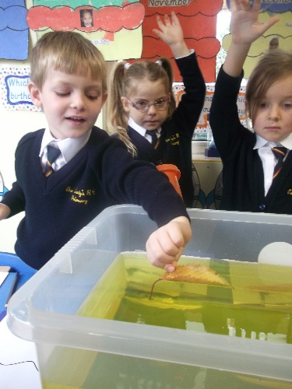
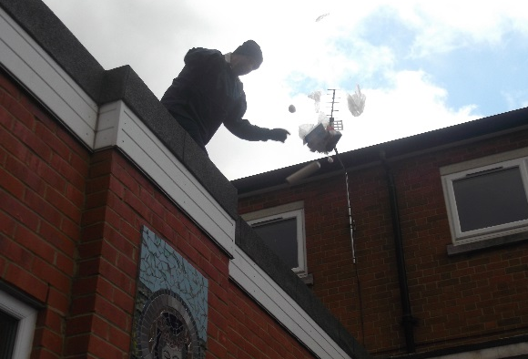
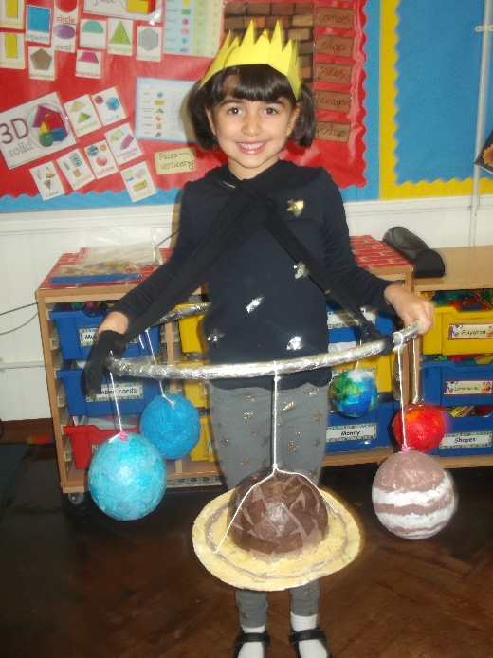
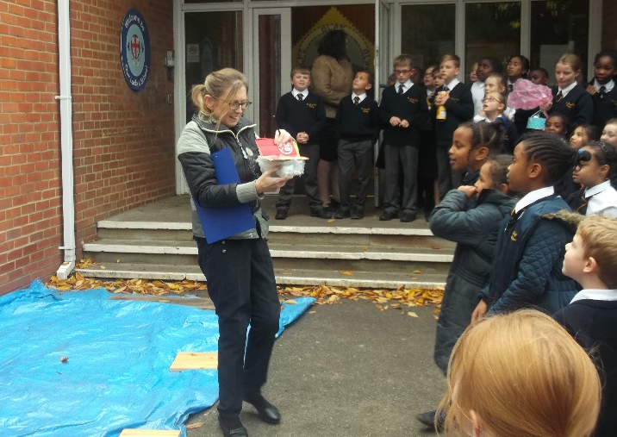
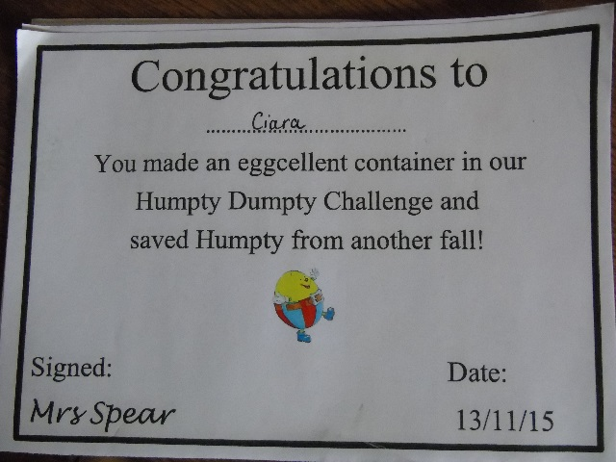
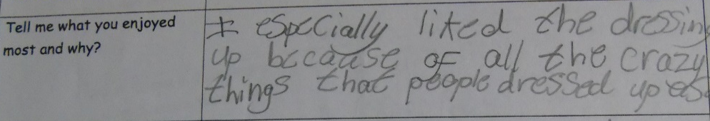
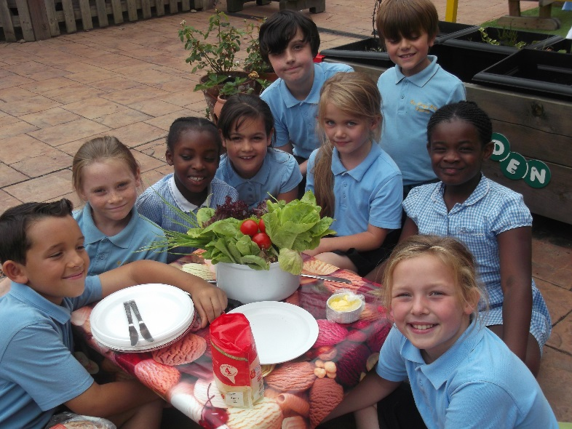
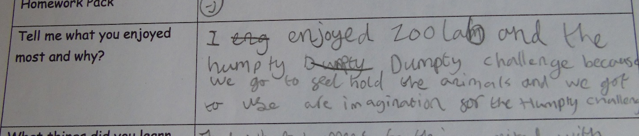
Children enjoy their science experiences in school.
Dress up as ‘something scientific’
I loved seeing what whether things float or sink in jelly
Humpty Dumpty Challenge.
Making a container to protect Humpty from a fall!
Even our caretaker got involved!
Year R
Gardening club was good fun – especially when we got to make sandwiches with what we grew.

Slide 7
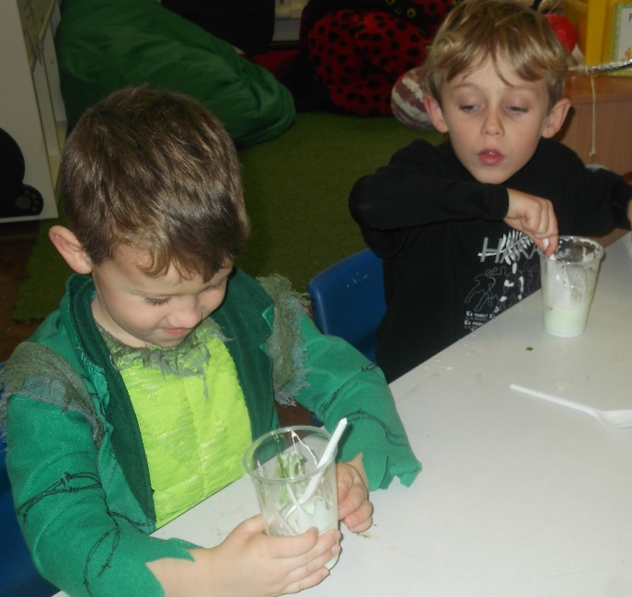
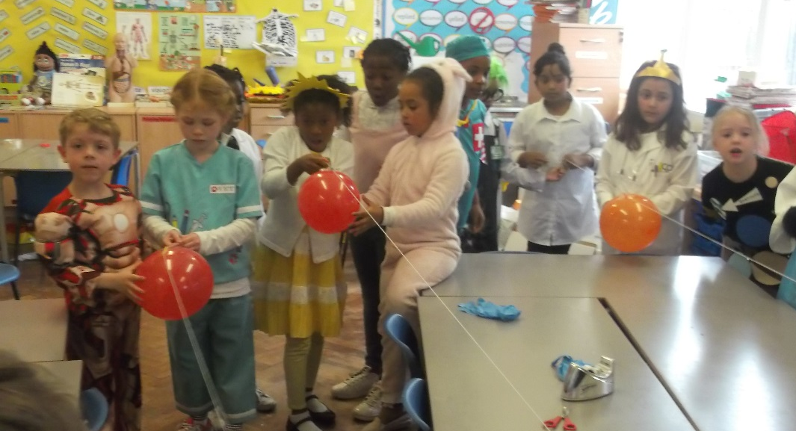
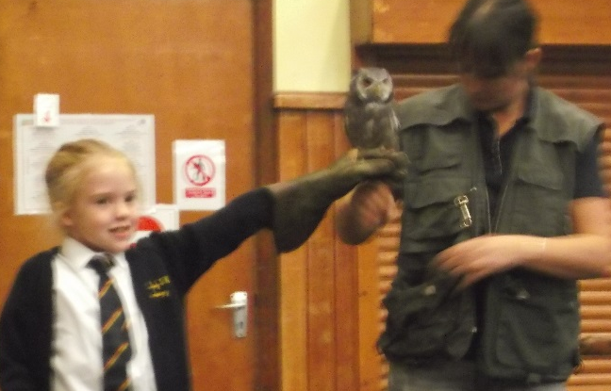
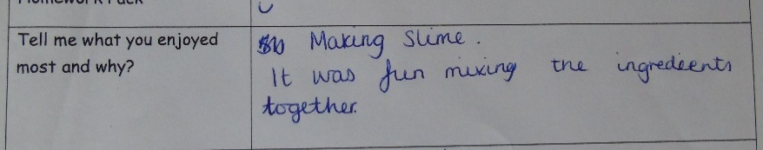

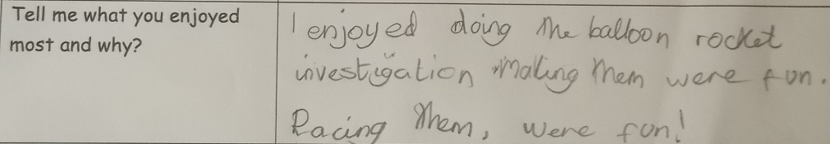
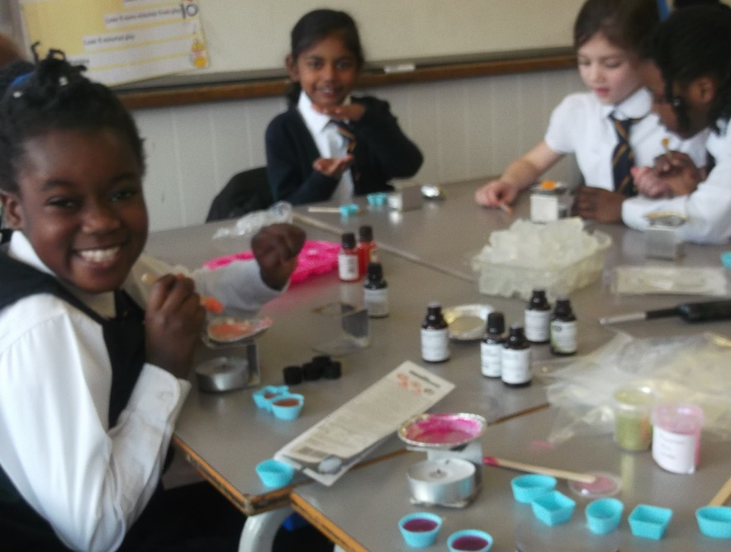
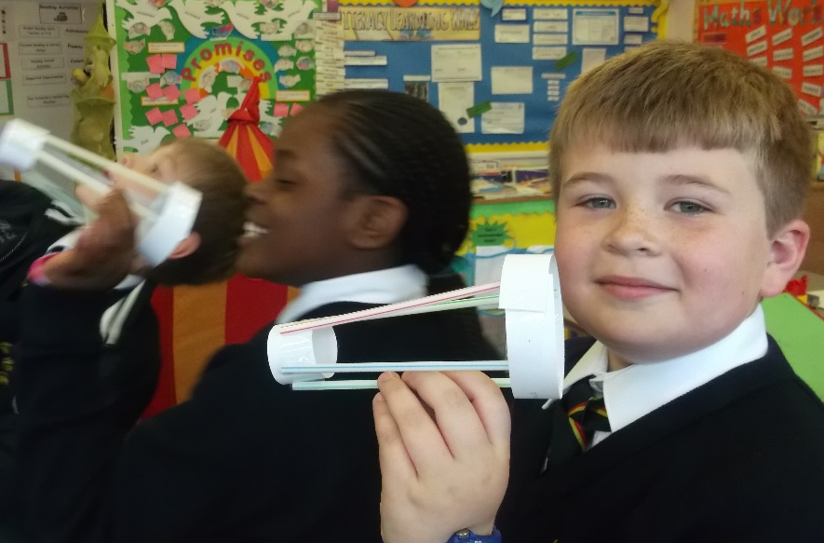
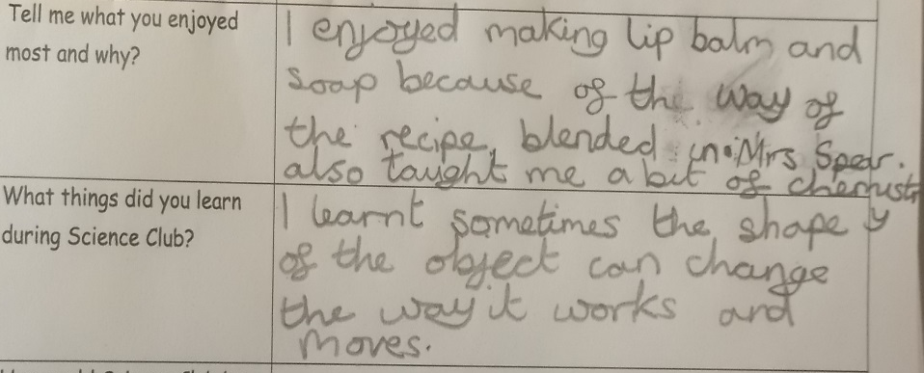
Owl Time
Year 1
Whole school
Science Week Slime and balloon rockets.
Year 3 and 4
Science Club
Years 2-4
I like the way my zappy zoomer moves!
Examples of feedback on Pupil Voice

Slide 8
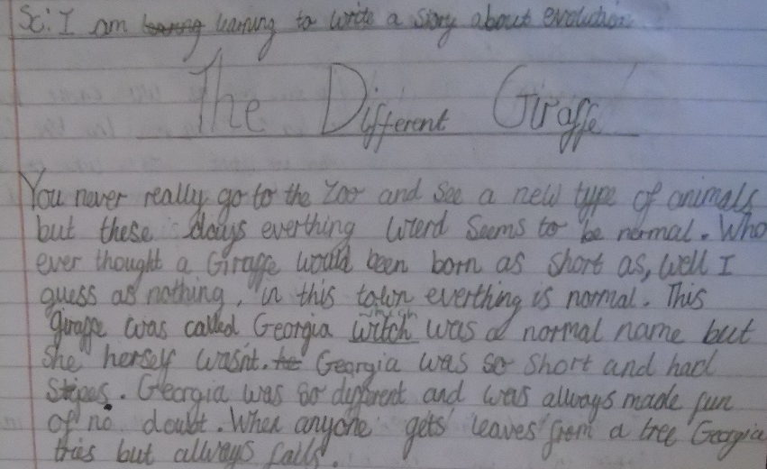
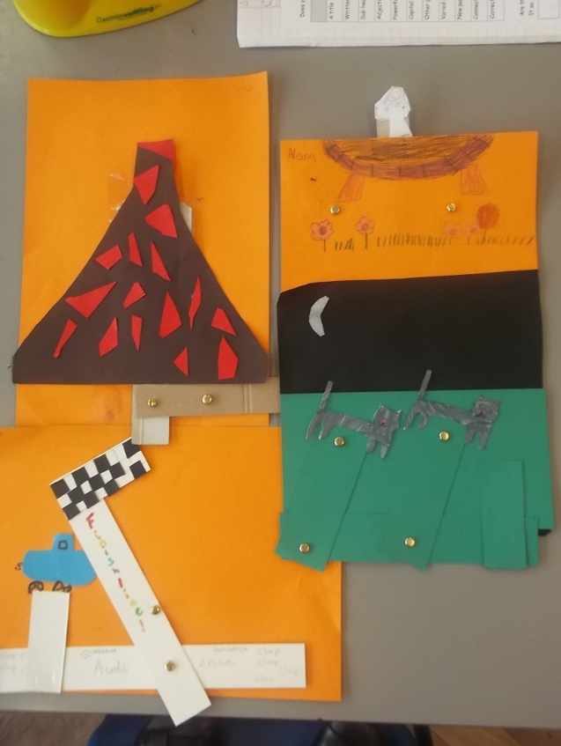
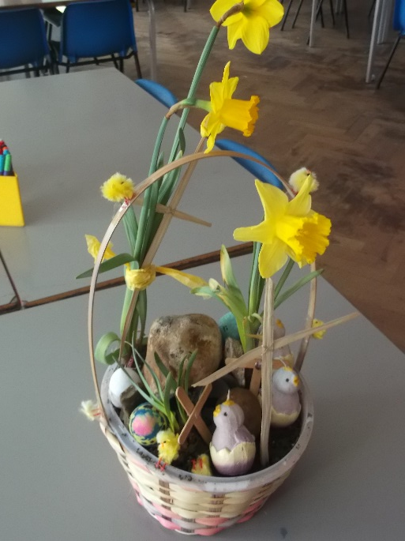
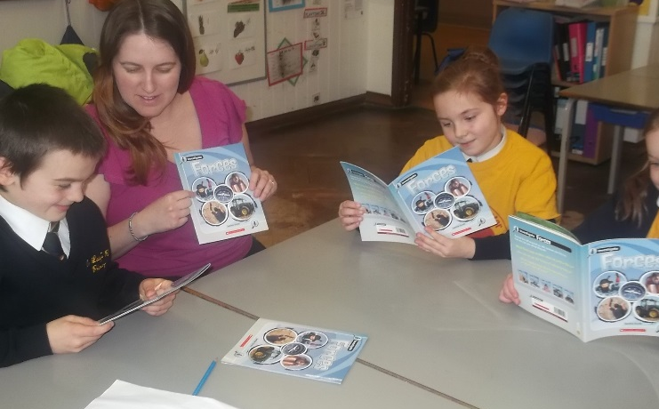
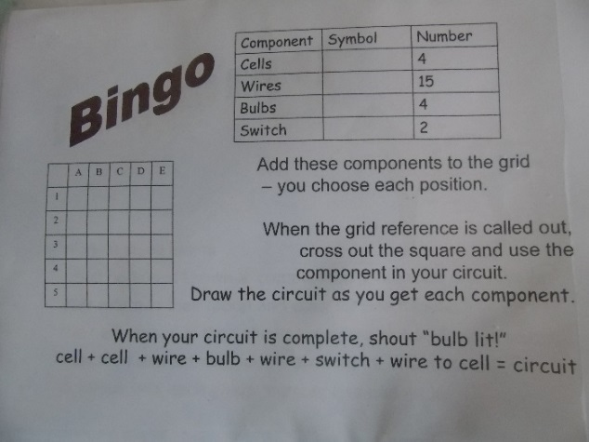
Science supports and links with other curriculum areas and contributes to maximising whole school initiatives while retaining its unique status
Writing ‘Just So’ stories literacy supports work in ‘evolution’.
Year 2
Year 6
Year 3
Investigating how bulbs grow in order to make Easter baskets in RE
Creating a page from a moving book on forces in DT (levers and linkages).
Using knowledge of coordinates to create an electrical circuit
Reading about forces in Guided Reading has helped me understand more about friction
Year 6

Slide 9
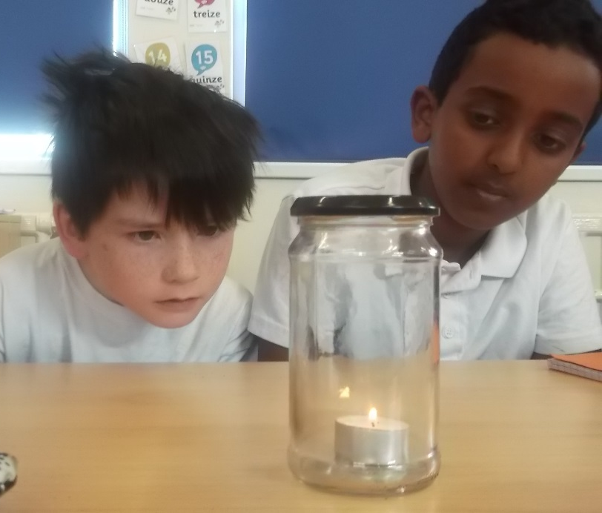



Year 5
Year 3
Cross curricular links on plans.
Year 6
Cross Curricular Links
Tudors- family trees. Explore the Tudor family tree – what similarities can they see amongst the portraits of each member of the family line? Which of Henry’s children take after him the most? Why? What is the scientific reason for this?
Linking Tudors with Evolution and Inheritance
Year 3
Learning about the effects of burning on pollution in the atmosphere through a geography unit on climate change.
Cross Curricular Links
Maths – measuring: Use their previous lessons in measuring length to support their measuring of each other’s jumps. Remind them how we measured objects around the room with different measuring instruments. What unit would be most appropriate? What equipment will they choose to use to measure the jumps today? How will we record our results?
I can see black soot on the jar. That must have come from burning the candle.
Use maths skills to support measuring in science.
Cross curricular skills – using pictograms to show which parts of plants are eaten in a week.
Yummy and healthy
During Black History Month, children made Moroccan cous cous to support their understanding of a balanced diet.
Using knowledge of finding averages in maths when taking repeat measurements,
Year 6
Year 3

Slide 10




There are clear links to other schools and outside agencies/organisations/ communities to enrich science teaching and learning
I can’t believe I am touching a snake!
That was the best trip I have ever been on! Do we get to go next year?
Number in a year of: Class | trips | Visitors | Enrichment
Year R | 1 | 4 | 5
Year 1 | 3 | 4 | 3
Year 2 | 1 | 4 | 4
Year 3 | 1 | 3 | 5
Year 4 | 1 | 3 | 5
Year 5 | 2 | 5 | 6
Year 6 | 3 | 3 | 3
Year 5 and 6
Year 4
Year 1-5
Overnight at the Natural History Museum
Zoo Lab – A very popular science week activity.
End of year trip to the Science museum enriches lessons from during the year.

Slide 11






I love it when Nev comes from Freshwater Theatre. He is so funny and he brings great science stuff with him
Year 5
Woodlands Farm
I’ve never seen real sheep before…. only pictures
Year 1
Standing astride the Meridian line!
School Journey to France
I never realised microorganisms could be useful to make bread!
Semi Year 6
Year 6
Forces workshop
Year R
Planetarium and Observatory Greenwich
Learning about micro –organisms in class then seeing them in action!

Slide 12






It’s great seeing Natalie arrive each week, it means we can work in smaller groups and children learn more
Year 3 teacher
I’m definitely going to be an astronaut when I grow up!
Living Eggs
Year R,1,2,3,5
….a fantastic resource to support the children with their understanding of the world….
Reception teacher
Year R
Year 5/6
Year 3
An excellent choice for a school trip. Really educational but loads of fun
Parent helper
Dartford Girl’s Grammar School Science Fair
Pupils have opportunities to meet real scientists and try out a range of scientific equipment and investigations.
CAS students from Dartford Girl’s Grammar supporting science lessons across the school.
Bedgebury Pinetum

