Slide 1

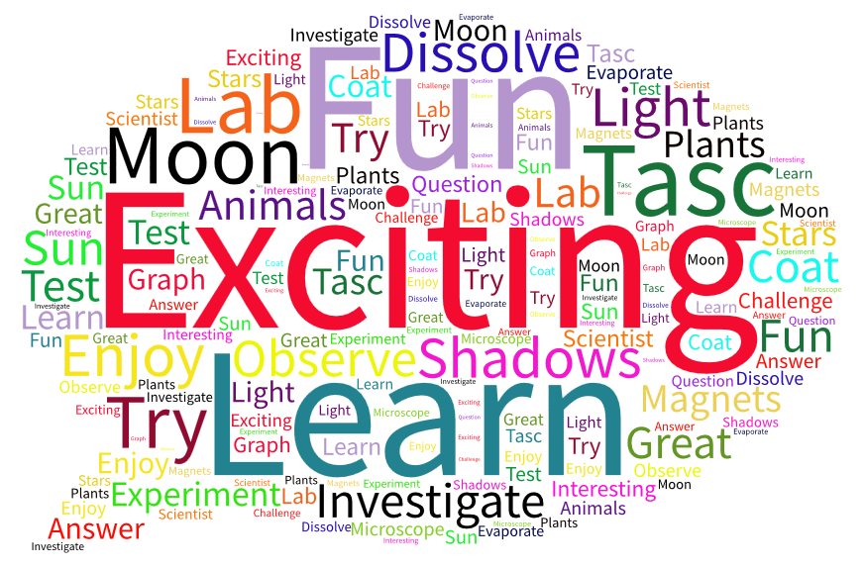
Our Lady’s Catholic Primary School
We are Primary Science Quality Mark GoldTM As of May 2016
‘This is what we think when we hear the word SCIENCE’
Pupils of Our Lady's Catholic Primary School

Slide 2
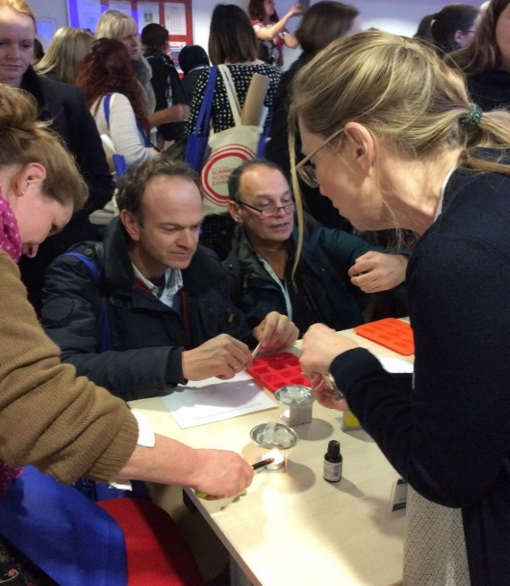
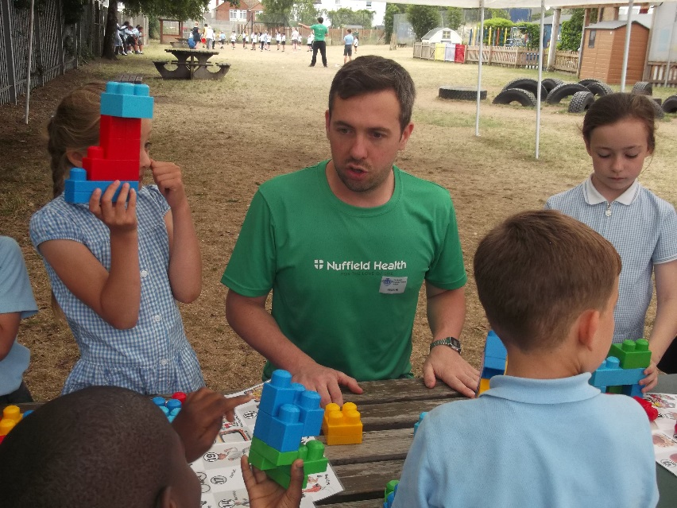
There is an effective subject leader for science
Sharing expertise with Hartley Primary School
‘Thanks so much for all the ideas’
‘My job share is going to run it with year 1 and 2 for this term and then I am going to run it during the spring term with different children as you suggested.’
‘Science club is going well’
‘Thanks for all your advice re the mock inspection. She seemed happy with our responses’.
‘We would very much like you to come and share some of your excellent science work with us.’
Extracts from emails from Hartley Science Coordinator
Delivering Primary Pop Up session on cosmetic chemistry at the ASE conference.
Developing national resources with Nuffield Health/Edcoms
Excellent pace of lesson leading to fully engaged children and acquisition of knowledge, skills and understanding
Good use of IWB
Wide range of scientific vocabulary used
Well prepared and resourced lesson
Differentiated appropriately
Good scientific subject knowledge of all staff
Engaging and appropriate investigation
Extracts from lesson observations across the school.
’’Peer observations really helped me with my own lessons’
NQT

Slide 3
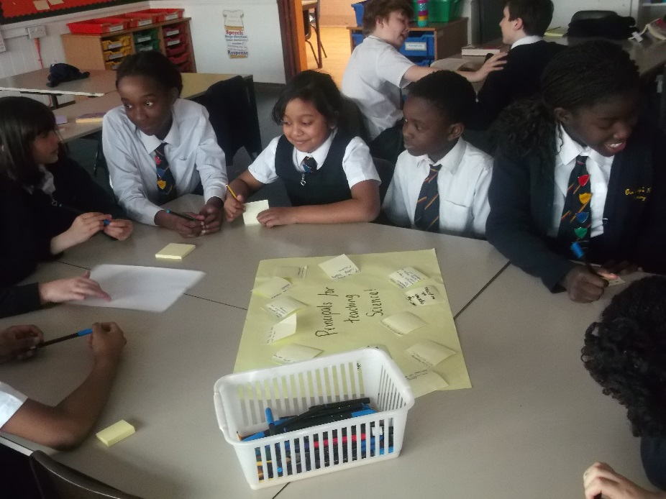
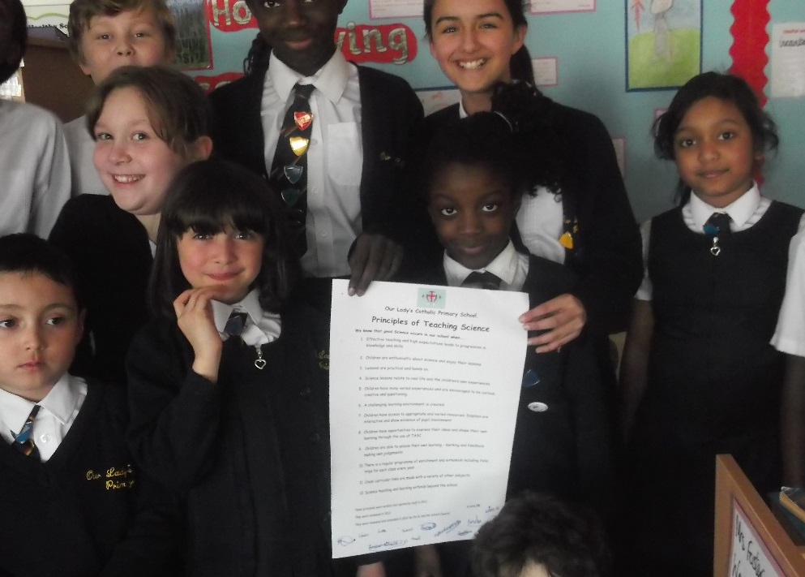
There is a clear vision for the teaching and learning of science.
I was glad we were able to say what we wanted science to look like. Now I know we will do more fun stuff like trips and science week.
School Council member
It’s great the whole school know our Principles of Science
Head Girl
School council reviewing and amending our Principles.
Taking them round to share with every class

Slide 4
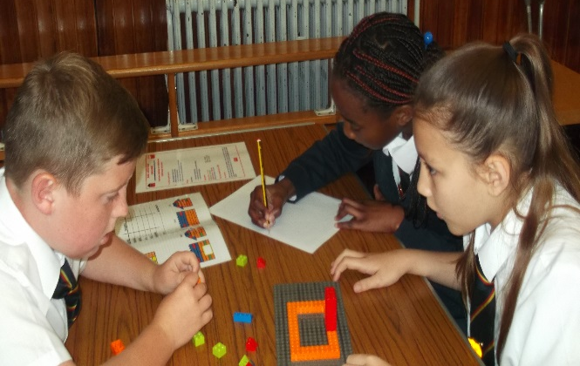
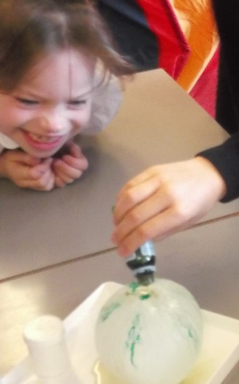
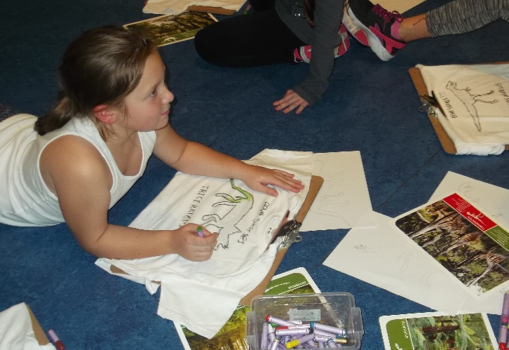
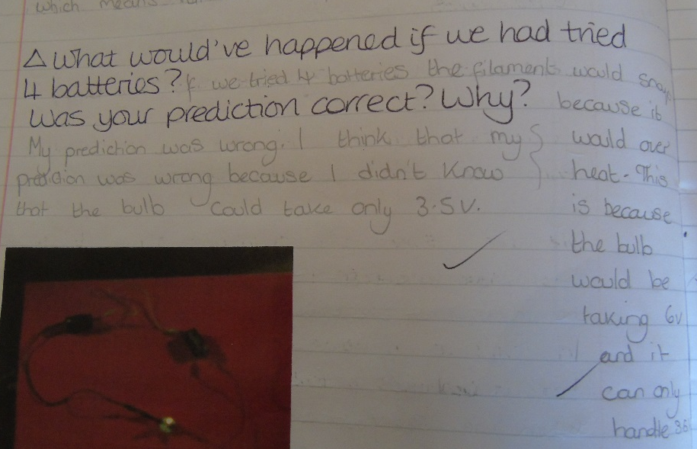
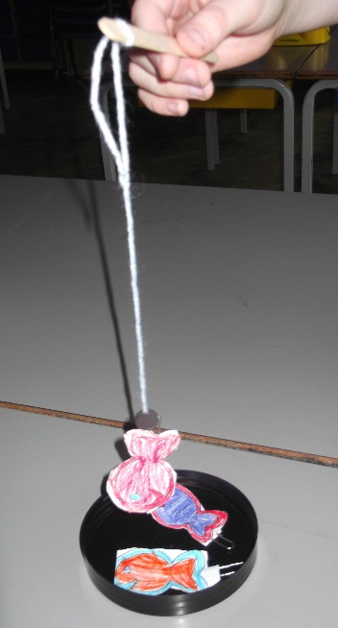
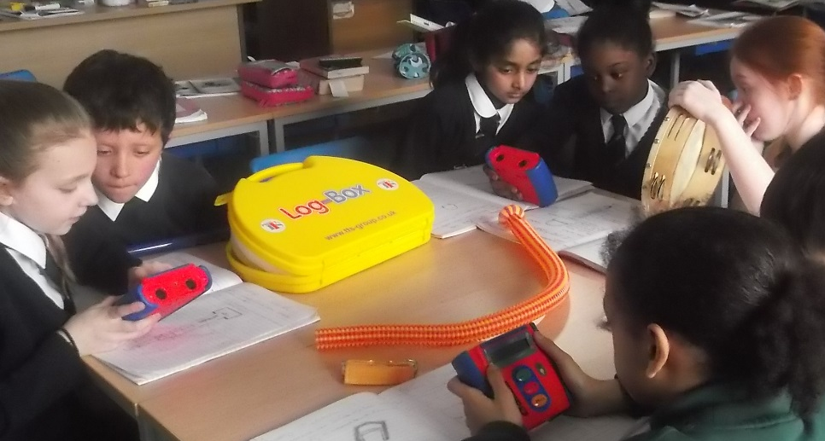
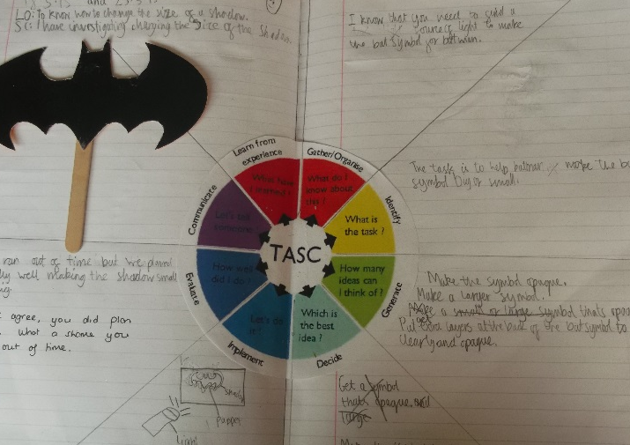
I cant believe I am sleeping at the Natural History Museum!
Our Principles in action.
Year 3
Wow!
Year 5
Year 5/6
Lessons are practical and challenging!
Pupils are enthusiastic!
Pupils assess their own learning through marking and feedback.
Pupils have varied experiences and a variety of enrichment!
Year 6
Year 3
Year 5
‘I got to invent my own magnetic fishing game in science
Year 3
‘I got to help Batman improve his Bat Signal!
Lessons relate to real life
Resources are varied and appropriate.
Pupils shape their own learning through TASC.

Slide 5
Our Principles in planning.
Learning Objective/ SC | Key Questions – including AFL | Tasks, differentiation, groupings and adult support and TASC opportunities | Resources/ ICT
To be able to describe materials I am learning to describe and sort materials by how they feel. | What is the property of a material? How does it feel? Is it stretchy? What happens if you look through it? Can it be broken? Vocab Property Hard Soft Stretchy Shiny Dull Rough Smooth Bendy Transparent sticky | Hook into lesson Touch challenge. Begin by asking a child to hold an object and describe what it feels like: rough/smooth, flat/bumpy, sharp/blunt. In small groups, children could be given a feeling bag in which one of the children in the group will place an object from a collection. The other children take it in turns just to feel what is in the bag, and then describe it. Observation activity – What are the properties of the different materials? Put the activity into context: Play sound clip of Curator of the Science museum who is creating an exhibition of different materials based on their properties and she is not sure how to sort and display them. Are Year 1 able to help? Talk with the children about how they sense the world around them (touch, see, hear, smell and taste). Inform them that they are going to be great sense detectives; able to identify materials by using their senses to work out the properties of the materials. Put a range of objects in the middle of the circle. Ask ‘How could we sort these materials into different groups?’ Take suggestions after using talk partners. Explain that today we are going to sort them through touch. Demonstrate this activity to begin with by feeling the surface of the material. Highlight that it is not the materials or object we are sorting but how it feels. Place objects that have the same property in a sorting circle. Then match the property to the circle using the vocab posters. Repeat by passing around the objects do chn can feel and place it on the correct property poster. Now put the posters on the tables and as a whole class chn have to sort all of objects onto the tables according to the properties. Recording / Differentiation/ adult support: Some children will be able to: draw an object and write two properties to describe it using the texture word bank on iwb. Others will be able to: Use the ‘how it feels’ template of hands. Chn to cut a small section of different materials and write a word to describe the texture. Create a large poster and photocopy for evidence. KS: work with the Snow White table in sorting the objects according to their feel. Give a few examples for chn who need more support. KW /CB: work with the gingerbread table as above. | Feely bags A range of objects made from a variety of materials-both natural, synthetic familiar and unfamiliar. Vocab posters Templates for recording Sound clip
Year 1
Express their own ideas
A range of resources
Relate to real life
Encouraged to be curious
Practical
High expectations

Slide 6
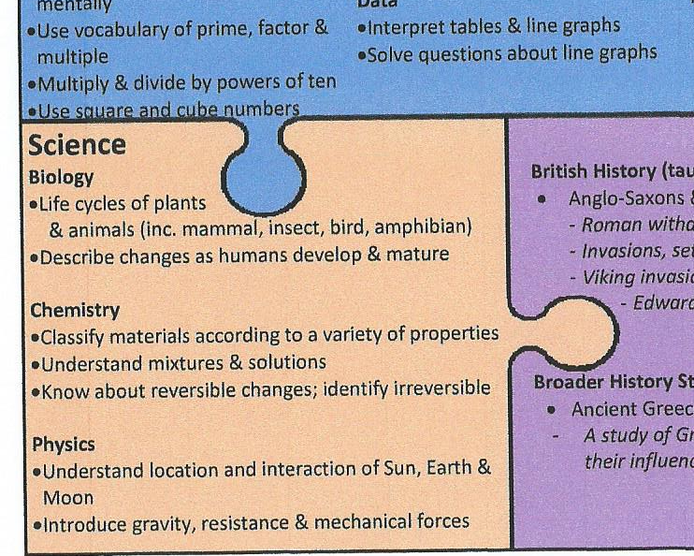
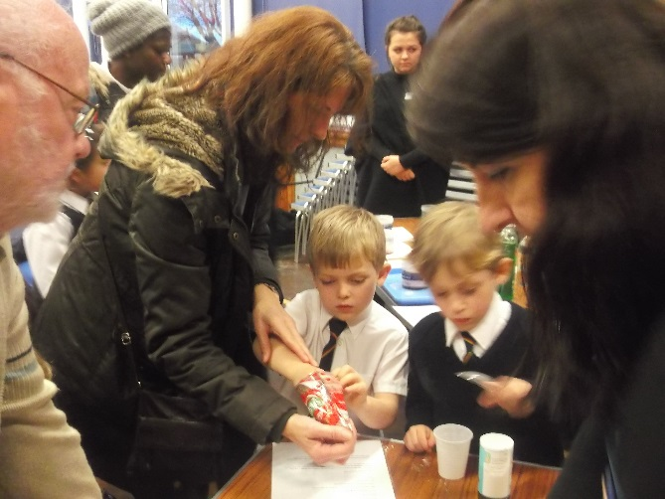
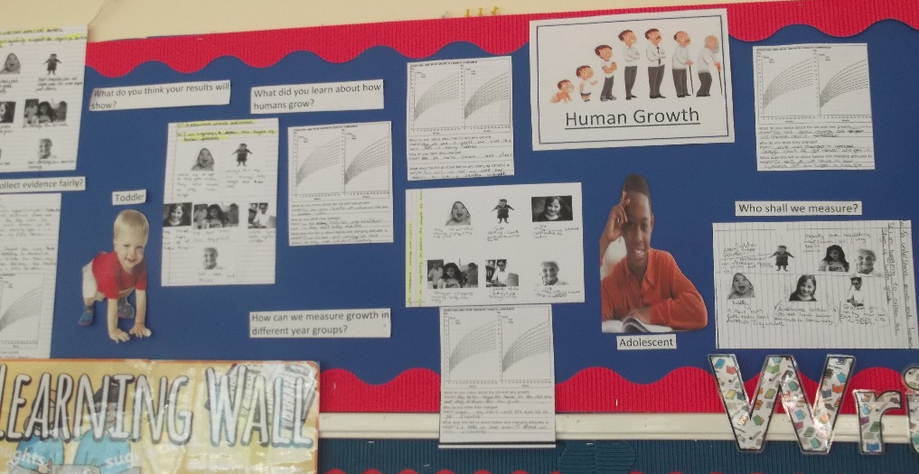
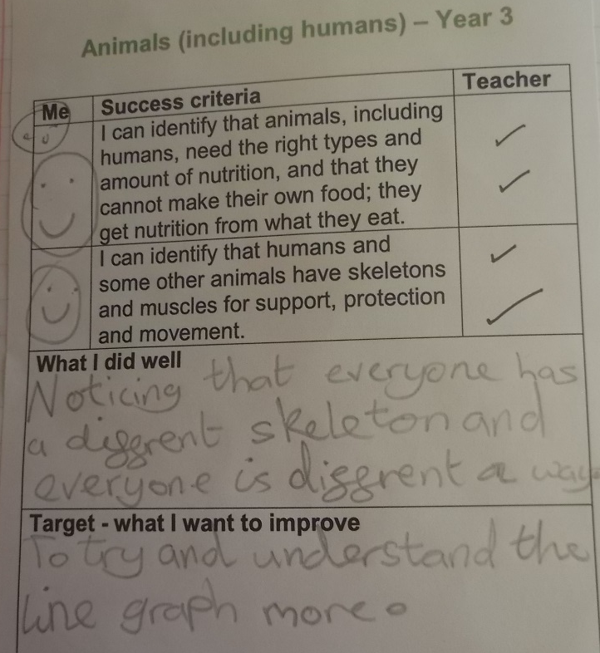
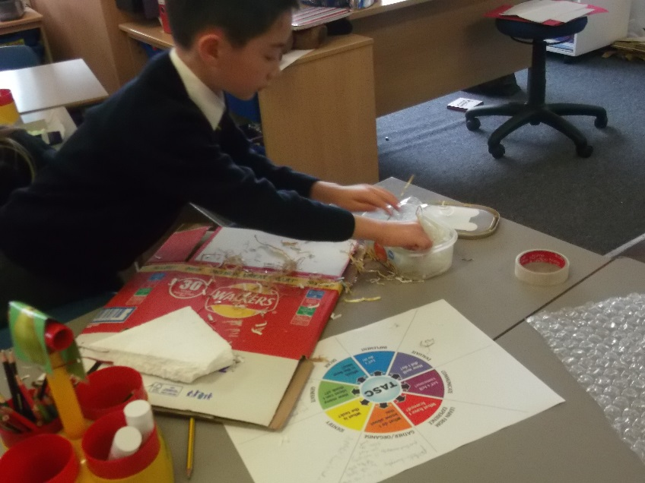
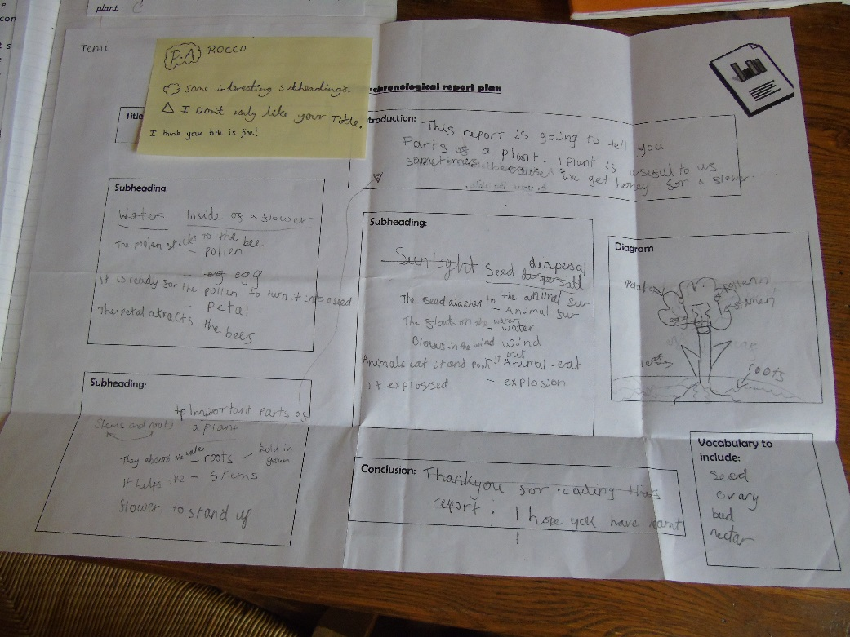
The current School Development Plan has appropriate and active targets for science.
Year 5
Year 5
Communication with parents – extract from parent information booklet.
Hold Parent workshop to keep parent informed
Development of working walls
Year 3
Year 3
Year 2
Cross curricular work – eg science and literacy – planning for an information report on the parts of a plant.
Develop new assessment procedures and targets
Embed TASC

Slide 7
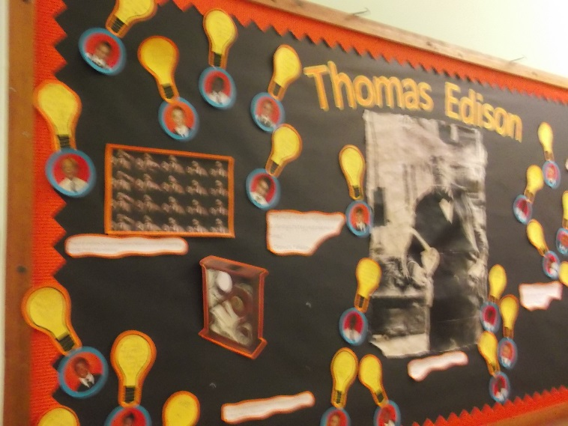
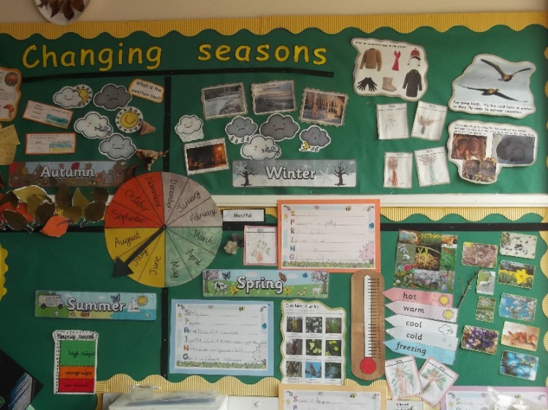
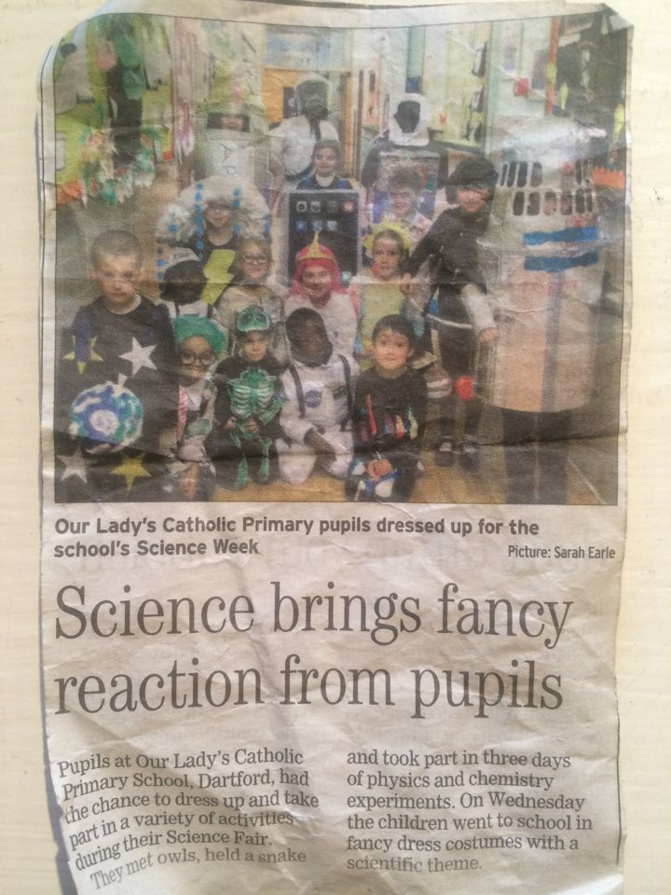
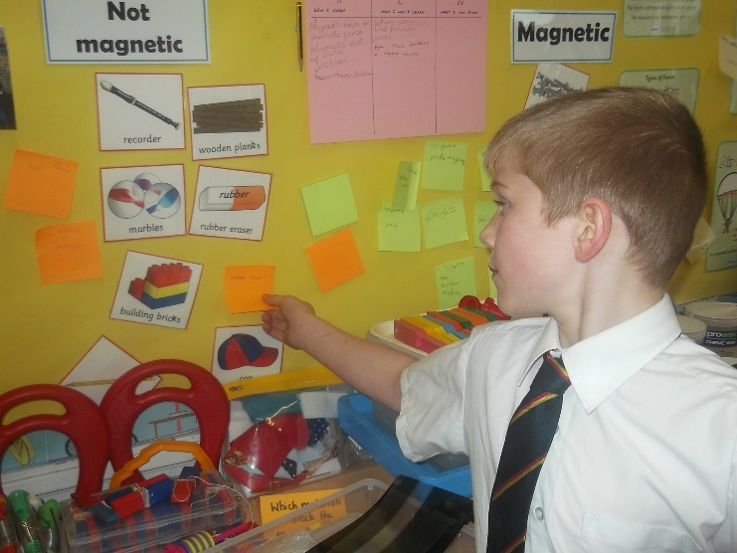
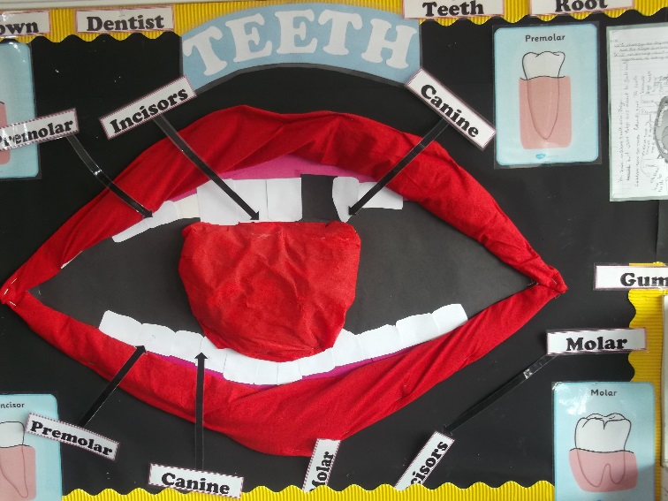
There is a shared and demonstrated understanding of the importance and value of science to children’s learning.
Science Week activities make the local newspaper showing the local community we value science.
Year 2
Year 1
Working walls in classrooms and displays in communal areas support learning
Year 3
Year 4

Slide 8
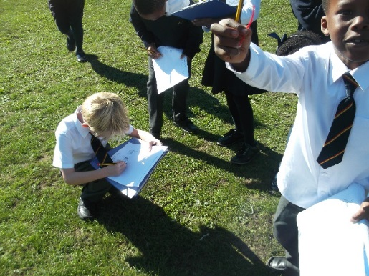
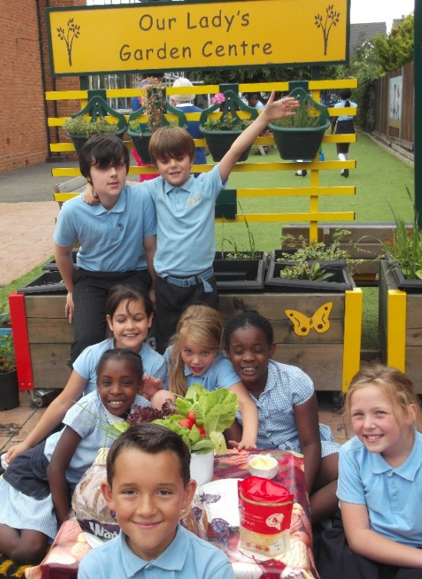
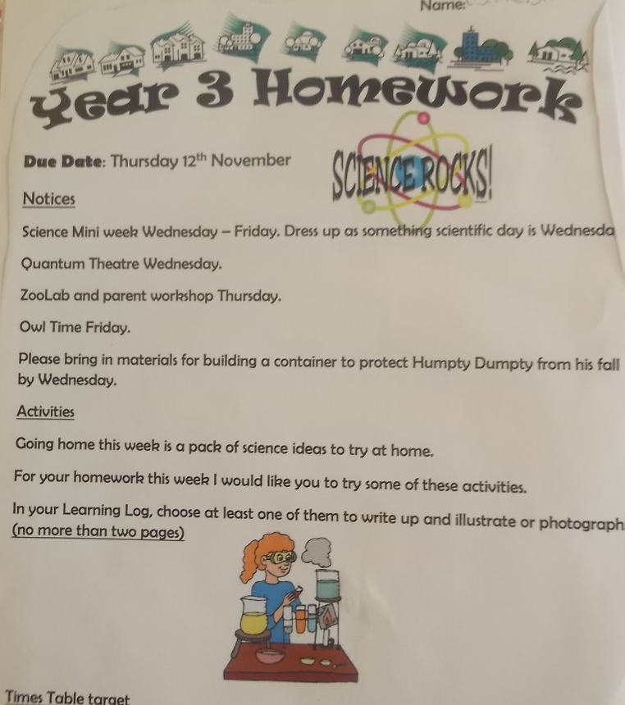
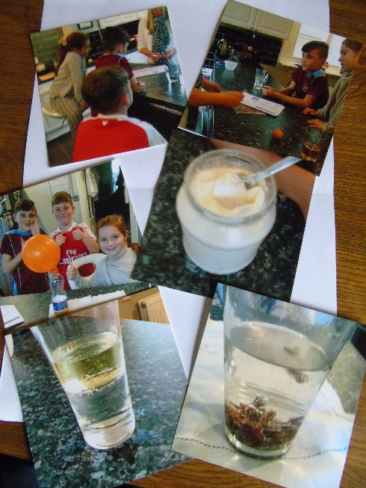
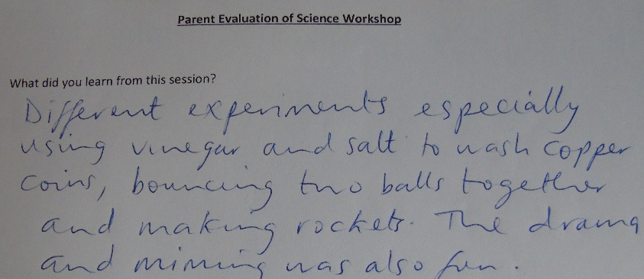
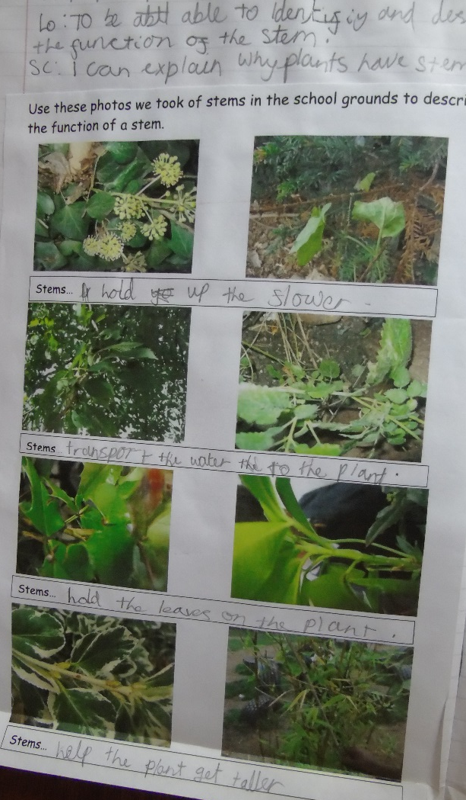
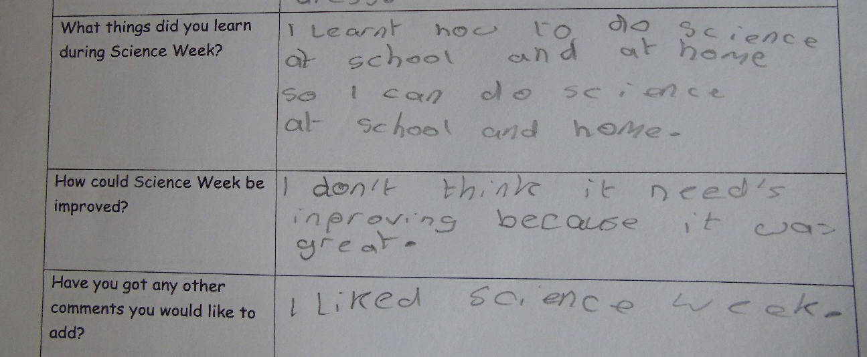
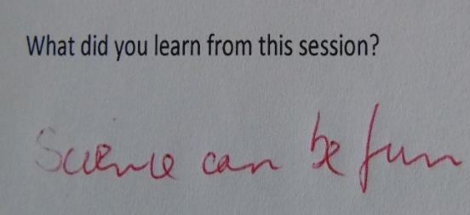
Photos from home of science activities
Year 2
Developing the school garden – gardening club
Using outdoor space to support lessons.
Years 2-5
Science homework involves pupils and parents.
Year 4
Year 3
Positive feedback following parent workshop during science week.
Positive feedback from pupils following science week.

Slide 9
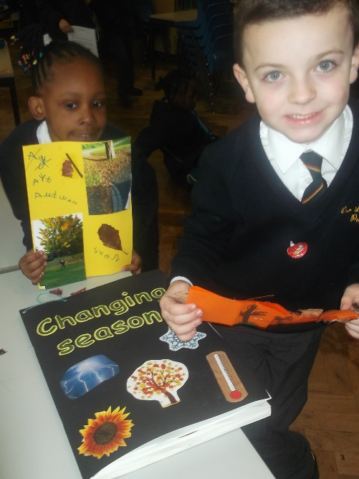
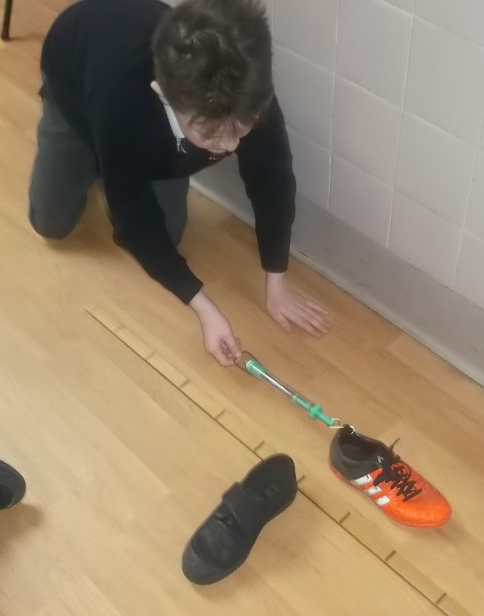
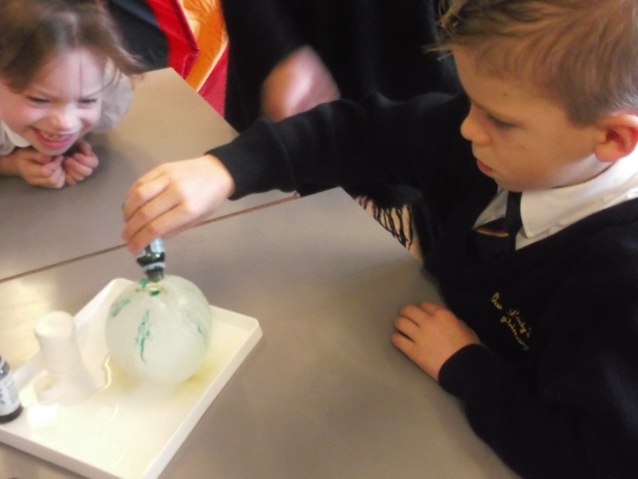
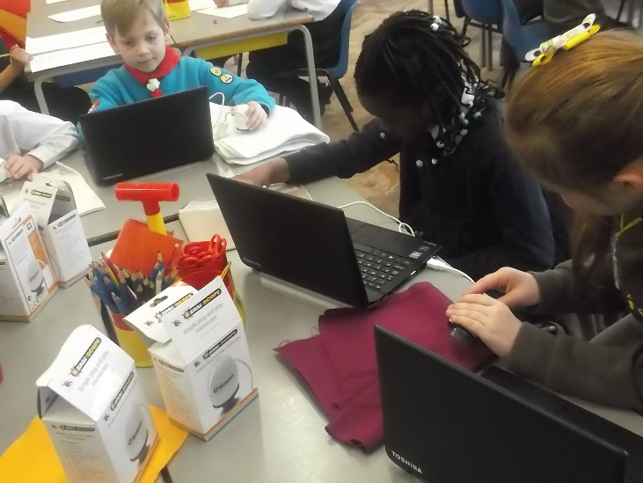
The science coordinator knows about science teaching and learning across the school
Year 1
TASC to find the shoe with the best grip.
Children were able to choose the correct equipment and use their maths skills during this lesson
Lesson observation Year 5
There is evidence of lots of investigative work in a variety of contexts being completed.
Work scrutiny Year 1
Year 5
Year 5
Year long investigation into seasonal change
The children thoroughly enjoyed their science activity today. What a good context to teach it through.
Observation of science week activity Year 2
Year 2
Year 3
There is a good range of resources indicated on planning.
Planning scrutiny Year 3
Using microscopes to investigate why some materials have greater friction than others
‘Why do we salt the roads in winter?’ Real life context for lesson.

Slide 10
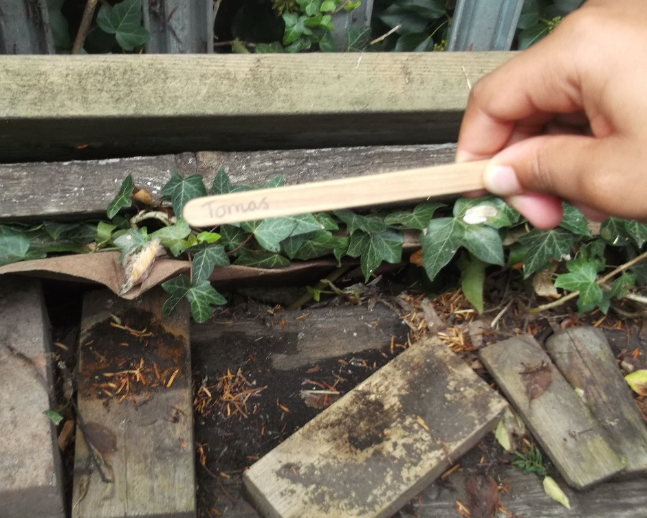
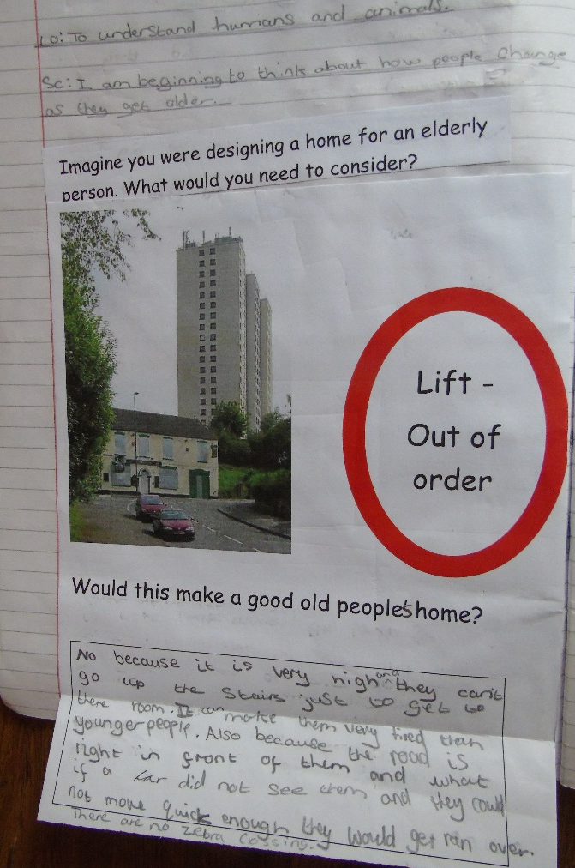
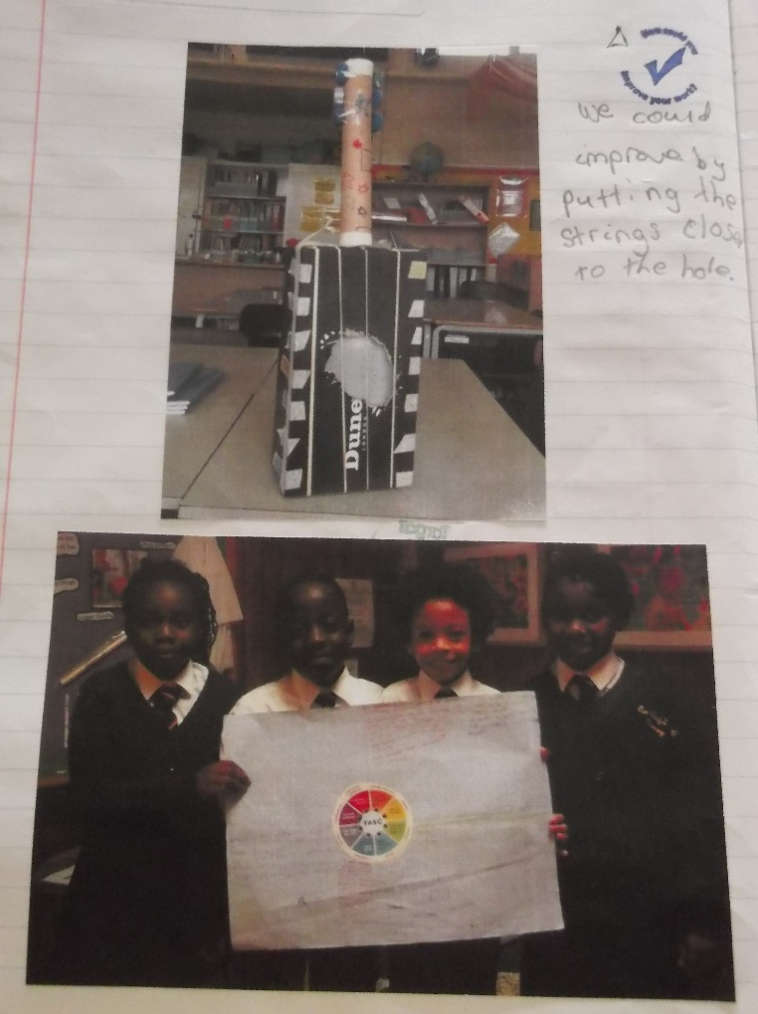
Try using more real life contexts within your lessons
Work scrutiny Year 5
Work shows how teacher responded to feedback to set lesson in a real life context:
Year 5
Year 4
Becoming an ‘estate agent’ for a minibeast.
Year 2
Identifying how sounds are made through vibration.
Learning about changes as we age.
Plan in opportunities to use the outdoor environment effectively.
Planning scrutiny Year 2
Activity shows how the teacher responded to feedback with creative and contextual learning
lesson included opportunities for children to make observations, explore resources, discuss their findings as well as complete a TASC.
Lesson observation Year 5

Slide 11
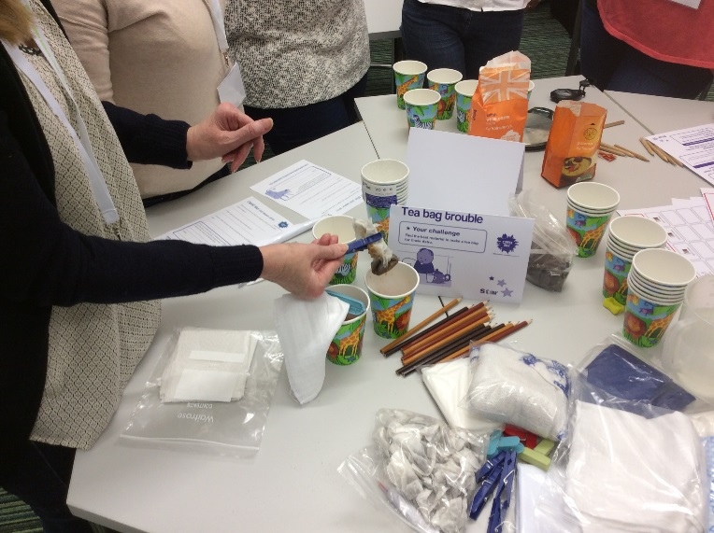
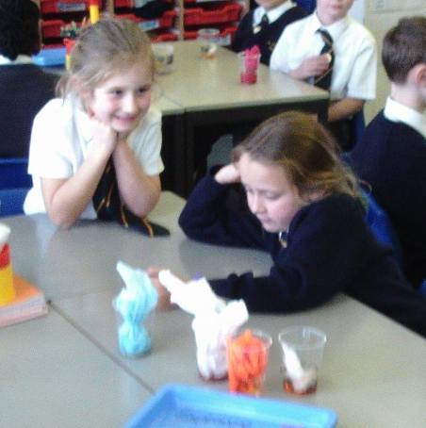
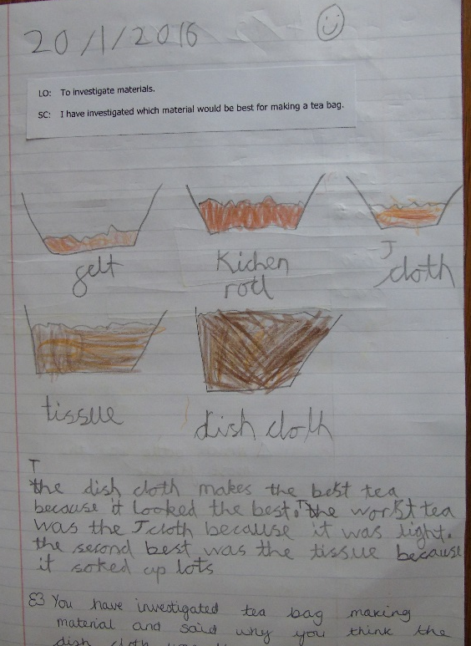
Staff continue to have opportunities for CPD within science that increases their skills, knowledge and understanding.
CPD opportunities in a year Year group | CPD in house | External CPD
Year R | 7 | 1
Year 1 | 6 | 1
Year 2 | 7 | 2
Year 3 | 3 | 4
Year 4 | 9 | 1
Year 5 | 6 | 1
Year 6 | 7 | 2
I was shown a great way of teaching materials in context during a workshop at the ASE conference. I then planned the investigation with my class and it was a great success.
Year 2 teacher
I felt well supported in science during my first year.
NQT
Feedback is always helpful and constructive
Year 5 teacher
We were very well prepared to deliver our science week activities
Class teachers
TASC training showed me how to teach lessons in context
Year 6 teacher
Investigating the best material for a tea bag
Watching the science coordinator teach gave me lots of ideas
Year 1 teacher

Slide 12
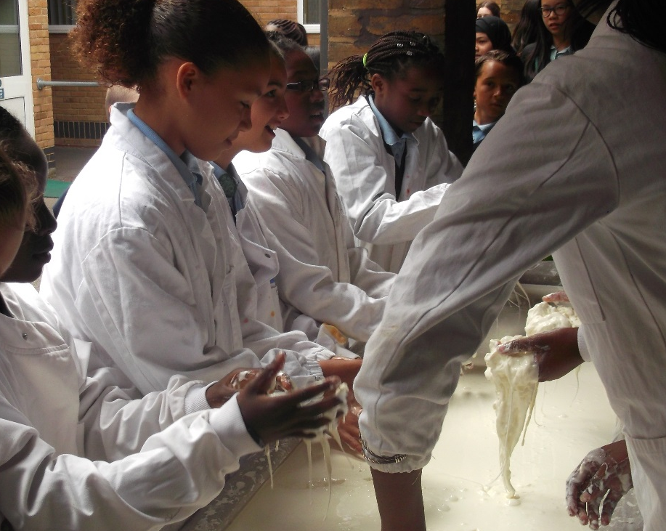
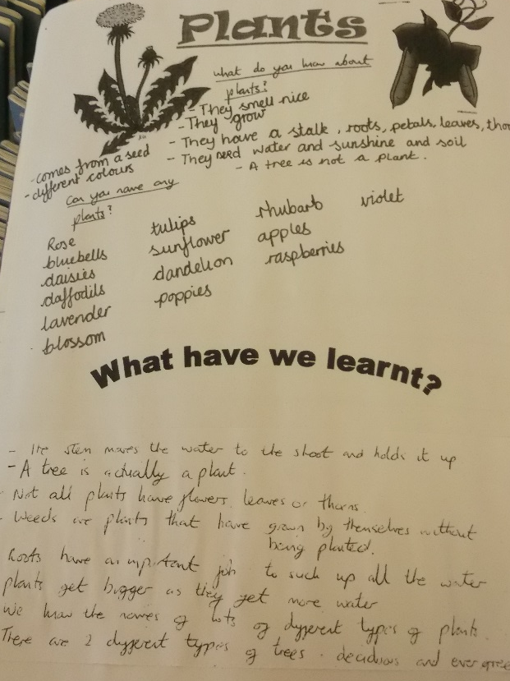
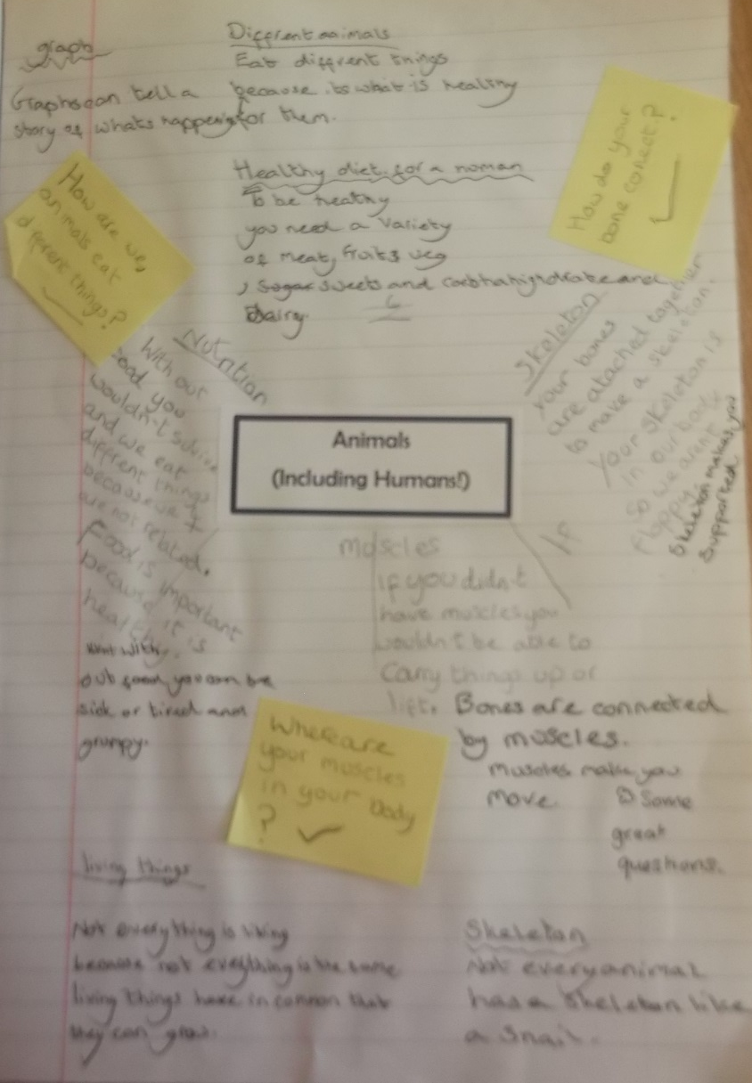
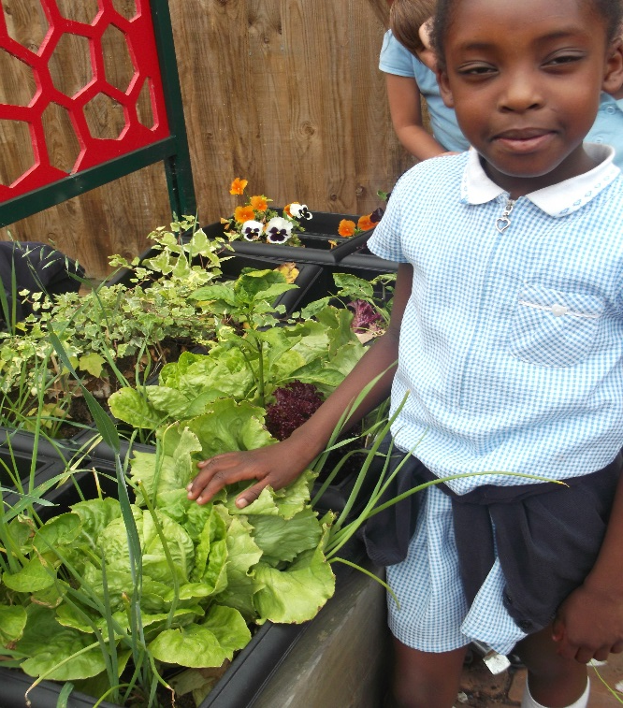
There is a range of teaching and learning approaches for Science.
Field trips
Concept maps
Years 5/6
Year 3
Concept map
Planning
Outdoor learning
Year 1
Becoming scientists at the Grammar school Science Fair
Year 2
Using the school grounds
Concept map is developed by the class.
I can’t believe my seeds grew into these lettuces!
Then by the children with increasingly less support.

Slide 13
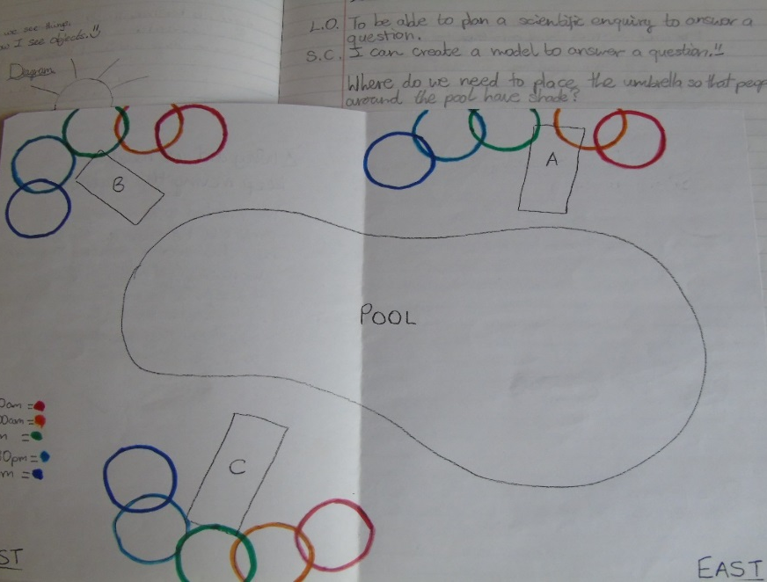
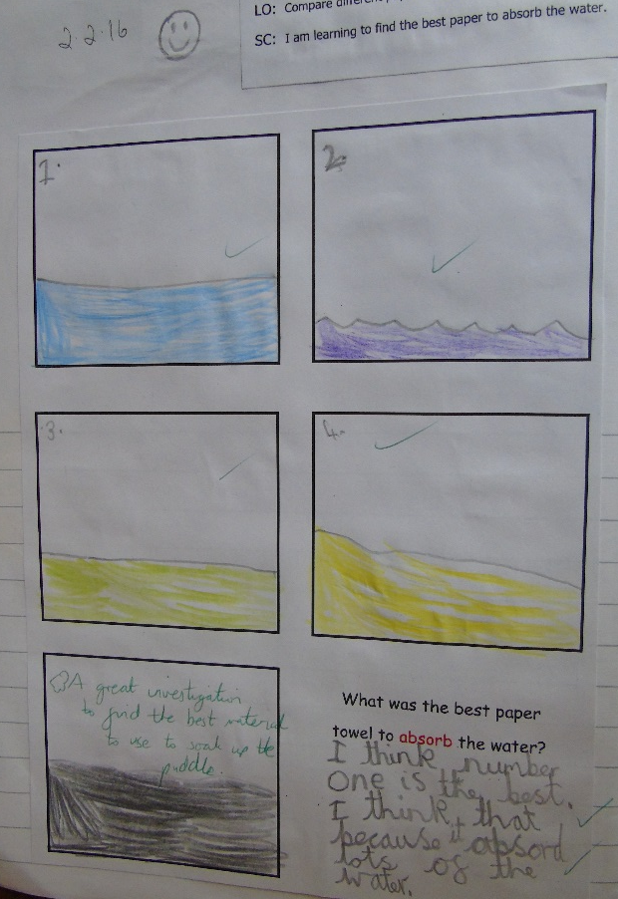
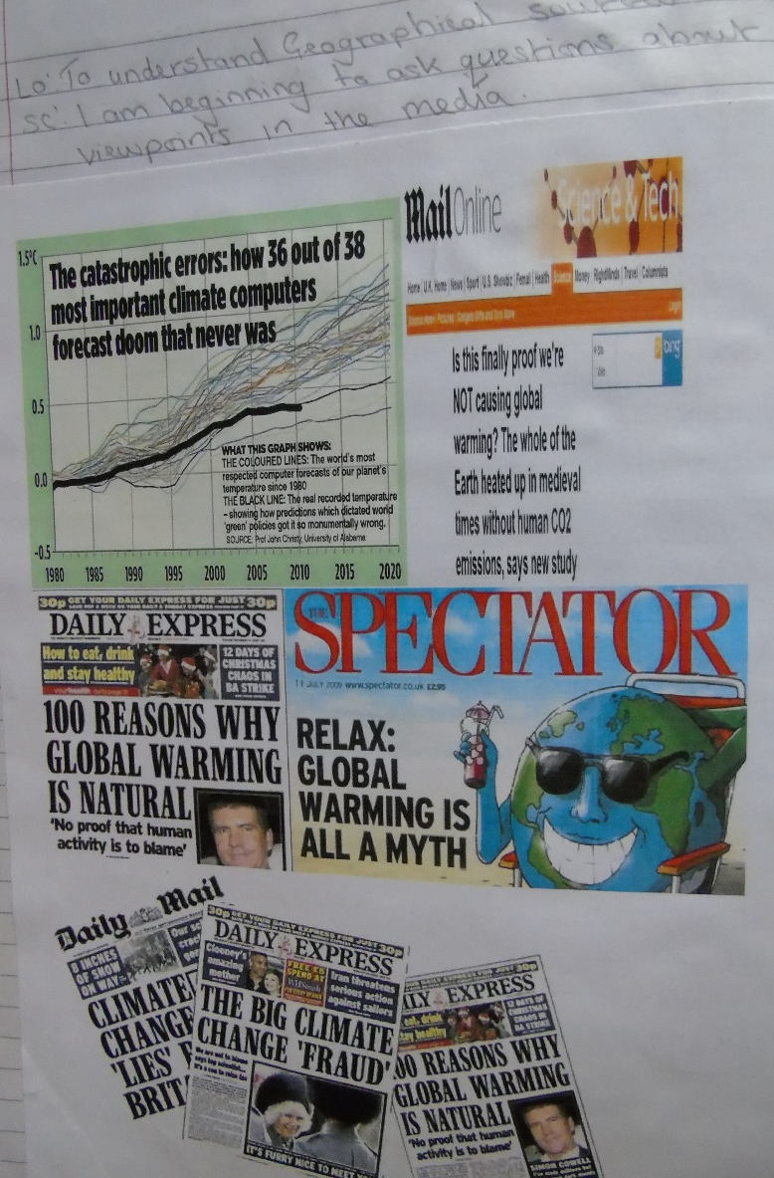
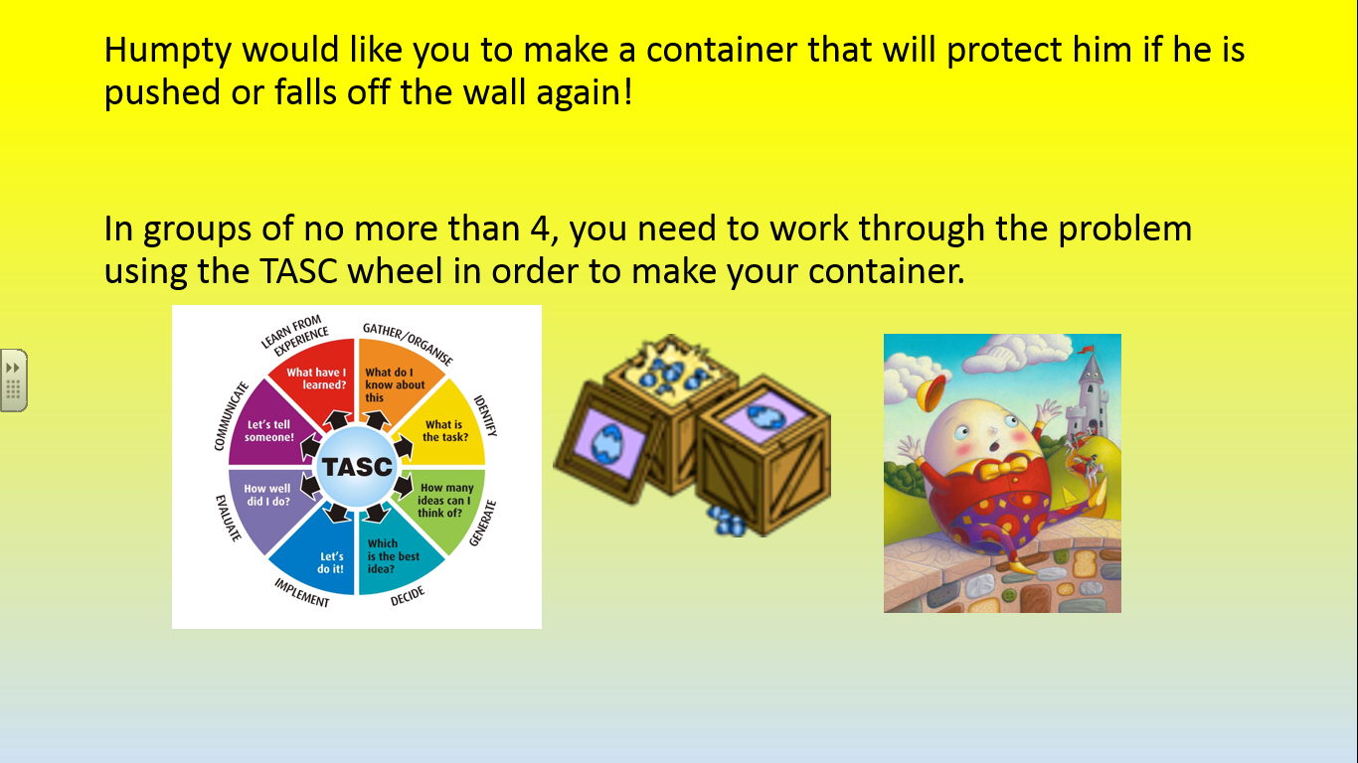
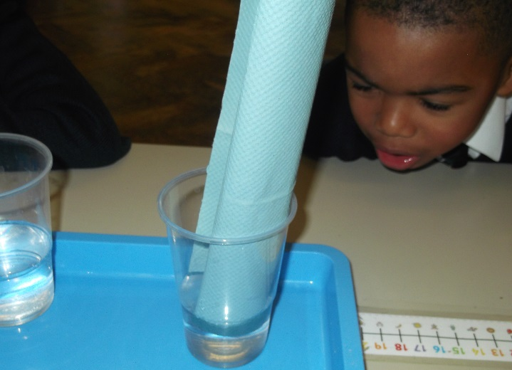
Teaching in context
Modelling ideas
Cross curricular approaches
Year 5
Which paper towels should the school buy?
Year 6
Where to place the umbrella so people around the pool have shade.
TASC
I think the blue one because it absorbed the most water.
Year 2
Examining environmental issues in geography to question different viewpoints in the media.

